Slide 1
THE ROAD USER
Copyright © 2016 STC, UK
Notes:
The purpose of this module is to identify the characteristics of the road users and understand the factors that influence their decisions. There are several modules within the “Road User” theme. First, general information is presented dealing with trends and statistics of the driving population. Next, an overview of attitudes and behaviors is discussed relating them to highway safety. The third section deals with age and gender issues as they affect highway safety. The effects of alcohol use on highway safety are discussed as well. Finally, licensing issues are presented to provide current efforts that could have an impact of safety.

Slide 2
PART I--OVERVIEW
Notes:
The first section of the module will present the basic statistics and road user demographics and provide an overview of the issues that may influence road user safety behavior. The various demographic trends are presented and discussed in order to understand their potential influence in shaping how to address safety in the US. During the presentation, the discussions will focus on identifying how demographics, societal changes and social trends could influence road safety needs.
Question: In what ways do age and gender influence road safety?
Answer: Three ways demographic factors influence safety are physical ability; physical vulnerability; and risk-taking behavior

Slide 3
Some Statistics-2013
More drivers now than ever (212 mil)
Most people who can drive do (85%)
More elderly drivers (65+ 17.3%)
Fewer teen-age drivers (4.2%)
Slightly more females
2013 Highway Statistics, FHWA
Notes:
Current statistics indicate that in 2013 there were more drivers in the US than ever. Based on the Bureau of the Census statistics, of the 251 million population of driving age, approximately 85% have a driver’s license. One should be careful here, since this does not necessary mean that all drive but rather they hold a driver’s license. This percentage is lower than in the past (when in 2000 it was 88% and in 2010 86%) and it may indicate a shift in attitude changes towards less driving.
The population of elderly has increased as it compares with past trends (more discussed in the next slide) and it now occupies 17.3% of the driving population. This is also coupled with a lower percentage for teenagers (19 and under) may present a significant change in demographics and may have impacts both on driving habits as well as crash rates.
Finally, there are more female than male driver license holders than in the past (105 million males and 107 million females). As a comparison, in 2001 the numbers were 96 million males and 95 million females.
Question: What may be the reasons for this shift?
Answer: Females live longer than males and there are also more females in the population (2013 statistics show that females were 51% of the population).

Slide 4
Elderly Drivers (65+)
Highway Statistics, FHWA
Notes:
The shift and increase of female licensed drivers over time is apparent in the graph. The share of elderly females drivers over time has increased and this reflects a number of temporal and societal trends. According to he Bureau of the Census, it is anticipated that by 2030 people over 65 will account for 20% of the population.
The larger number of older drivers could impact road safety. For example, past research shows that older drivers are involved in higher proportions than other drivers at intersections especially when dealing with a left-turn maneuver.
Question: What are the reasons for this change?
Answer: Changes in traditional family roles (driving was done by the male in the 50’s), increased presence of females in the labor force in the 60’s translate into more older drivers in the 80’s and 90’s, and longevity of females (typically 3-5 years more than males).
4

Slide 5
Teenage Drivers (<20)
Highway Statistics, FHWA
Notes:
Teenage driving population has declined over the same period and is steadied at approximately 4.5% for both males and females. This reduction is both in the percentages as a proportion of the driving population as well as in numbers. For example, in 2000 there were 5.0 million males and 4.7 million females, while in 2013 they were 4.5 and 4.4 male and female drivers, respectively.
Question: Why do we observe this trend?
Answer: This could be attributed to: 1) reduced birth rates, 2) the “graying” of the US society as a whole, and 3) changing attitudes towards driving.
5

Slide 6
Why Need to Talk About it?
Crashes
Licensing
Aging
New technologies
Notes:
The question one may pose is why we need to focus on the road user. The answer is simple: they are the ones suffering from crash involvement.
In addition, the driver license is probably the most valued ID that one may posses: it signifies entry in the adult society and it can be considered an exit card (for elderly) if it is removed. Moreover, there are licensing issues that need to be considered that deal both with the early and late stages of driving.
Aging plays a significant role in the proper completion of the driving task (discussed in the next slides) and as such can have a significant influence on road safety. Moreover, population predictions place the elderly population at about 20% of the US population by 2030 (US Department of Health and Human Services) as opposed to approximately 15% in 2015.
Finally, new technologies have been introduced that can have an influence on the driving task and road safety. One can simply consider the potential impact of cell phones (distracted driver) or presence or antilock brakes (increased risk taking behavior) to understand their influence on driving behavior.
6

Slide 7
The Driving Task
Seeing
Perceiving
Understanding
Reacting
1.5-2 sec
Notes:
Even though the driving task components are discussed here, this sequence of perceptual process is one that all users (drivers, pedestrians, and bicyclists) are constantly engaging in.
The user first visually perceive cues, such as traffic signs, traffic signals, or pedestrians crossing the road. Then, they process the meaning of the cue and upon understanding its connotation, they react to the cue. This in highway design is called the Perception-Reaction time and is typically 1.5-2.0 seconds.
This is a fairly quick process and roadway users have to continuously evaluate situations and make decisions. Age affects all stages of this perceptual process. For elderly drivers, vision may affect their ability to see while for young drivers inexperience may affect their understanding of the situation. These differences in physical and perceptual ability increase the risk of crash involvement.
7

Slide 8
Vision
Roadway design to accommodate the 20/40 or 20/50 driver
Factors affecting vision
  Visual field reductions
  Visual acuity
  Accommodation
  Glare/Sensitivity
Notes:
Vision plays an important role in gathering information from the environment and could have a significant impact in the decision-making process. Typically, road users get about 80-85% of their cues from visual stimuli. A driver with perfect vision has a 20/20 vision, i.e., can see at 20 feet the letter sizes intended to be seen at that distance. A 20/40 driver can see at 20 feet what a person with no visual problems can see at 40. Roadway design is developed to accommodate drivers who may not be aware of their visual deficiencies.
Vision factors that are affected by age include:
Visual field: the ability to see at a field of approximately 160º focusing at a point without turning the head
Visual acuity: which is defined as the ability to see fine details, such as lettering on road signs.
Accommodation: which is the ability to understand how far an object is and how quickly it approaches the driver and changes size.
Glare/Sensitivity: ability to recover vision during nighttime when opposing vehicles approach the driver.
Roadway designers need to address these issues with a proper understanding and provide for potential accommodation for elderly drivers with elements such as signs with bigger letters, brighter signs, etc.
8

Slide 9
Visual Field
Notes:
This is an example of how peripheral vision changes with age. The green line indicates a normal 160º field of view. Age affects this range requiring persons to turn their head to accommodate any loss which may result in not seeing objects if they were looking straight ahead.
9

Slide 10
Detection
Driver expectancy
Dynamic environment
Notes:
The physical layout of the roadway along with its traffic control devices provides the required clues to drivers and as such it must be designed to provide the driver with information necessary to react to hazards; to predict what lies ahead; to select appropriate speeds, and so on.
Drivers rely on prior knowledge and form their reactions typically based on expected scenarios. Drivers expect signs and road markings to provide advice as to required changes and rely on them to make their decisions. Without this information, the driver’s ability to make appropriate decisions is impaired. Moreover, the roadway design itself provides drivers with cues as to what lies ahead and what is expected from them. Drivers rely on their prior knowledge to to associate and influence their behavior. For example, drivers anticipate that freeway exits are on the right side and designers need to take significant care to inform drivers for exits on the left side of the freeway. In general, road designers strive for predictability and consistency in design so drivers can effectively anticipate what lies ahead.
The driving environment is dynamic and as such requires drivers to exercise their ability to judge how far away an object is and how fast it is moving by determining the change in its size as it approaches. This coupled with aging deficiencies and possible slower reaction times may hamper older drivers and reduce their effective reaction to a hazard.
10

Slide 11
Perception & Reaction
Ability to ignore irrelevant information
Use of redundancy
Immediate recall
Mental workload
Physical abilities
Notes:
Once the road user has seen and detected a situation, then it has to determine whether the information received is relevant to the task at hand. For example, reading an exit sign that is not their destination is irrelevant and it could be processed and ignored. On the other hand, a STOP Ahead sign could be relevant, since a STOP sign is coming up. Both young people and older adults may have difficulty in sifting through information to determine their relevancy to what they are performing. Though not conscious of it, drivers constantly filter out a large amount of sensory information.
Road users use redundancy to understand a situation. This means that they are using prior experiences to evaluate the condition and determine the appropriate reaction. Familiar information is recalled from the immediate recall and new information is stored for future scenarios and reactions to them.
All this continued process of information increases the mental workload of the road user and can affect the rate with which decisions are made. An overloaded road user may ignore relevant information to the situation at hand or may not consider it as relevant as needed to be. In this case, this could lead to a safety issue and could result in inappropriate reaction. Young drivers maybe overloaded because they do not have adequate rules for ignoring irrelevant information while older drivers may have a tendency to process all information received.
Once the stimulus has been seen, perceived and a reaction is determine, the driver must carry out the decision through physical motion. The reaction requires drivers to use their physical abilities to complete the reaction. For example, the driver must have the ability to steer the vehicle to a new direction, turn their head to see traffic coming from the side, brake with the required force, and so on. Aging plays a role in this as well with the deteriorating physical abilities of older drivers and this can further compromise their safety.
11

Slide 12
Mental Workload
While driving, a driver has to
  observe traffic
  react to traffic conditions
  navigate vehicle
  think continuously
  fumble with other stuff
Notes:
Mental workload is defined as the work required by the brain to process stimuli and information. For drivers, this can be very demanding, since the driver needs to :
Observe and monitor multiple sources of information. For example, a driver approaching a signalized intersection going though must evaluate the signal display, ensure that no vehicles are turning right from the side street, there are no vehicles turning left from the oncoming traffic and check for vehicles in the in other lanes while simultaneously maintaining adequate spacing with the leading and following vehicles.
React properly to traffic conditions and understand and react to changes in the road environment.
Remember and apply navigational instructions while controlling the vehicle.
Deal with other elements, such as other persons, mobile phones, radios, navigational displays, etc.
It should be noted here that not all drivers can perform these tasks successfully and they often exhibit limitations while completing these skills. It is therefore imperative that roadways are designed in a manner that would allow enough time for individuals to recognize and process all these stimuli. For example, in deciding where to place warning signs in advance of a hazard, engineers take into account the amount of time needed to observe the warning signs, cognitively process the information, and react appropriately.
12

Slide 13
Outside the Vehicle
Built environment
Traffic Control Devices
  Traffic signs
  Traffic signals
  Pavement markings
  New generation signs
Other vehicles
Notes:
In addition to dealing with the vehicle, a driver needs to deal with elements outside the vehicle, i.e., with the built environment. The term “built environment” refers to all of the built features of the human environment including buildings, roads, fixtures, parks, and all other human-constructed improvements.
As previously noted, the built environment affects road user decisions while it provides cues to drivers and other travelers about how they should behave. Traffic control devices aid in this and assist drivers and roadway users in interpreting correctly the intended message and properly reacting to the stimuli.
Drivers also need to deal with the other vehicles in the roadway and thus understand their intentions and behaviors. The combination of the mental workload within the vehicle and the built environment with its distractions can affect the safety of the road users, since it has the potential to overload them and lead them to improper interpretation or disregard of stimuli resulting in incorrect reactions and thus compromising safety.
13

Slide 14
Inside the Vehicle
Radios
Cellular phones
Passengers
New generation devices
Notes:
The driver has to deal with a number of potential distractions inside the vehicle that can detract from the driving task on various levels. Radios and cellular phones can provide a distraction that can lead to inattention to the task at hand. Passengers can act both as a negative and as a positive influence. Drivers involved in conversations or dealing with children can be a distracted and miss relative information while passengers can also act as a set of extra eyes and assist in navigational guidance or increased awareness of upcoming situations.
Modern passenger vehicles are equipped with a wide range of new devices that can help drivers by assisting their navigation, actively prevent drivers from becoming involved in a crash or passively reduce the severity of a crash once it occurs. However, these devices may also have a negative effect since it is possible to confuse drivers and affect their safety.
14

Slide 15
What to Do?
Notes:
So the question of the day is what one can do to improve safety and deal with these issues?
Possible answers: revisit licensing programs (graduated license, restrictions for elderly drivers); increased training during licensure and license renewal;
15

Slide 16
PART II—ATTITUDES AND BEHAVIOR
Notes:
This module focuses on attitudes and behaviors of road users and how these can affect safety. Understanding the influences of these behavioral is essential for anyone interested in improving road safety. The discussion presented here can assist road safety professionals to understand and address the root cause of safety problems. For example, knowing that young drivers have a higher risk-taking behavior, one can then address this through education, enforcement, and engineering efforts specifically designed for this group.
16

Slide 17
Driver Aspects
Performance: What the user CAN DO
  Perceptual abilities
  Motor skills
Behavior: What the user DOES
  Judgments
  Emotions
  Options
  Risks
Notes:
There is a basic distinction between performance and behavior. Performance is defined as the ability of the road user to perform specific tasks. The perceptual abilities and motor skills are those elements that can affect performance and thus impact their performance. For example, elderly drivers have reduced motor skills (as discussed in the previous module) that can impact their ability to perform effectively certain tasks (such as visual search) and thus may require some compensatory actions.
On the other hand, behavior is defined as the actual acts the users completes and these are affected by their:
Judgments, where they could interpret a situation based on the available information and situational awareness;
Emotional status, where this could to distractions or different reactions based on this emotional status;
Options to resolve the situation, where these shape the eventual action of the road user (think in terms of same scenario but with limited or different options to react); and
Risk taking levels, where different groups of road users can react differently based on their willingness to take risks (as an example, mid-block crossings without crosswalks).
17

Slide 18
Basic Relationships
Skill & task difficulty
Task difficulty & safety
“We drive as we live”
Notes:
When it comes to driver performance, there are some relationships that need to be addressed. It should be also noted that driving is a “self-paced” task and as such there are certain concepts that influence individual behavior.
There is a distinct relationship between driver skill and task difficulty. It is clear that more difficult tasks require a greater level of skill to be completed properly. In general, drivers choose the task with desired level of difficulty based on their skills. For example, the task of keeping the vehicle within the lines on a straight roadway segment is easier than when a curve is involved, since this one requires both attention to vehicle placement and speed. Another example could be merging on a freeway, where younger drivers with limited skill may not be willing to undertake this more difficult task.
Difficult tasks could have a safety implication if not performed correctly. For example, during the taking of a curve (task noted above) improper speed can result in a ran off the road crash. The more difficult the task, the greater the chance is for creating a safety issue. For example, intersections pose a greater difficulty in the tasks required (observing others, vehicle placement and navigation, and completing maneuvers) and therefore the potential for safety concerns is greater.
A final aspect that should be noted is that lifestyles shape (and affect) driving styles. For example, persons who are greater risk takers in life are more willing to take risks while driving. Similarly, traits of caution, patience, tolerance, foresight, consideration, etc. also have an impact on driving behavior.
18

Slide 19
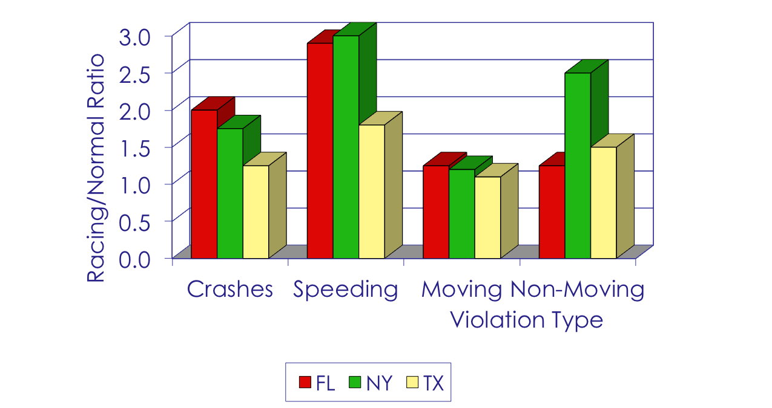
Racing vs Normal Drivers
Williams and O’Neill; AAP 6:263-270; 1974
Notes:
The idea that drivers with higher training, especially in crash avoidance techniques, would have a safety impact and could reduce the number of crashes. The idea of a national Master Driver’s License was developed in the 19070’s based on the concept that these drivers could be specifically trained to avoid crashes and be more familiar with vehicle behavior resulting in better safety records than those without the license. One could presume that car racing drivers are trained in such situations and have some experience in crash avoidance techniques. A study examined the on street performance of car racing drivers and compared their records with those of normal drivers in three states (where most of the car racing drivers resided at the time).
The findings indicate that in all violation types examined, the racing drivers have a greater number that the normal drivers. The results here indicate that the additional skills do not guarantee a safer performance.
Question: What may be the reason for these differences?
Answers: Greater confidence in skills could result in riskier behaviors (higher speeding violations); level of anticipated reaction from other drivers (i.e., in a race track all have similar skills and all behave a certain way which is not true for normal drivers wit different skills and experience).
19

Slide 20
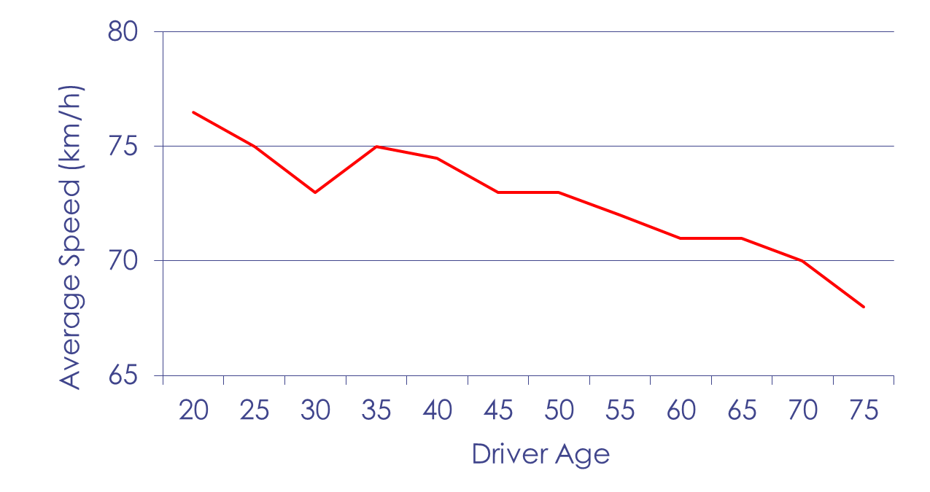
How Fast?
Wasiliewski, AAP 16:89-103; 1984
Notes:
People over their lifespan exhibit a changing behavior when driving speed is concerned. Young drivers have a tendency to drive faster than any other age group and over the lifespan, there is a reduction of about 10 km/h (6 mph) in average (overall) speeds. The higher speeds of young drivers could be attributed to their inexperience and greater risk-taking behavior. On the other hand, the lower speeds for older drivers could be considered as a compensating technique for their aging abilities and their reduced risk-taking behavior. A potential explanation for the dip in the graph at the age of 30 could be interpreted as the entry in the workforce indicating a greater income and possibly a newer vehicle and thus an increase in speeds.
20

Slide 21
Driver Personality
Psychological factors
  Tension tolerance
  Stress
  Personality disorder
  Immaturity
Social factors
  Maturity
  Attitudes against law
Notes:
There are several factors that could influence driver personality and their behavior in traffic situations and could have an impact on safety. Psychological factors can affect the way that one reacts to traffic conditions. These include:
Tension tolerance, where one can diffuse situations or accept more stressful conditions;
Stress, where one can depart from normal driving behaviors due to work or other related influences;
Personality disorders, which can influence driving behavior; and
Immaturity, when chronological age may have little to do with how one drives.
Social factors can also affect driving behavior. Such factors include levels of maturity, similar to the psychological immaturity, as well as attitudes against the law, where one may disregard signs and traffic control devices or existing rules (seat belt or helmet use for example).
21

Slide 22
Other Motives and Safety
Competitiveness
Sense of power/control
Pleasure/thrill seeking
Showing off
Notes:
Additional factors that could also have an impact on safety and can contribute to improper behavior include:
Competitiveness, where the feeling of “winning” every situation may pose threat in proper reactions. For example, overtaking other vehicles because one wants to be the first in line is a result of such behavior.
Sense of power is a situation where one is feeling powerful due to their ability to control a vehicle. For example, the sense of being able to control a four-wheel drive vehicle in inclement weather could lead to incorrect behavior and result in a crash.
Thrill seeking is another motive that could be detrimental to safety. This behavior can lead to taking higher risks than required and thus increasing the potential for a crash.
Showing off is a behavior that is typically noted among peers where the need to demonstrate one’s abilities becomes critical. This could lead into taking improper actions (driving faster than the conditions allow or braking at high rates) that can be detrimental to safety and lead to a crash.
22

Slide 23
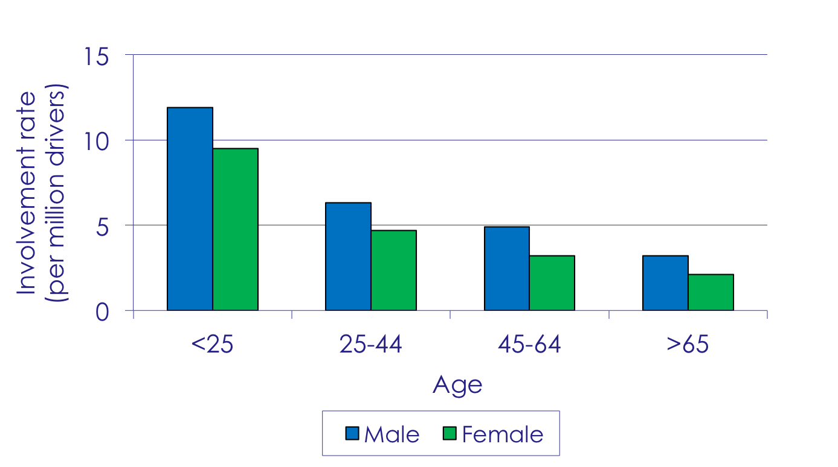
Risk and Age/Gender
Traffic Safety Facts 2006, NHTSA
Notes:
Age and gender have a role in determining one’s propensity to take risks on the roadway. Young drivers, especially young men, are much more likely to be involved in in a crash not only because of lack of experience, but also because of increased willingness to engage in risky behaviors such as drinking and driving, not wearing a safety belt, and speeding. For example, in 2004, the motor vehicle death rate for male drivers and passengers aged 16 to 19 was more than one and a half times that of their female counterparts (19.4 per 100,000 compared with 11.1 per 100,000). Recently, young women drivers have shown increases in crash involvement, but this phenomenon is not well understood and may be related to greater exposure.
As a result of in engaging these risky behaviors, a disproportionate number of young drivers die in car crashes. In fact, the risk of motor vehicle crashes is higher among 16- to 19-year-olds than any other age group. Per mile driven, teen drivers ages 16 to 19 are four times more likely than older drivers to crash.
23

Slide 24
Speed Choice
Sensual vs Utilitarian reasons
  Economic
  Speed limit
  Safe
  Actual
  Pleasant
Probability to be killed
Notes:
There are several reasons that one selects the speed they drive and they also based on both economic and behavioral aspects. People may drive fast simply because they have to get places within a certain timeframe or save time (utilitarian) while others feel better by driving fast (sensual). A NHTSA survey of drivers’ speeding attitudes and behaviors (NHTSA 2013) indicates that young drivers more often admit enjoying driving faster than older drivers; this is also true for males over females.
An issue that needs to be considered here is that often unconsciously, people select their driving speeds based on the likelihood of being involved in a crash and get killed. The same NHTSA survey on speeding attitudes noted that all drivers (regardless of age) consider the speed choice as a function of being involved in a crash.
NHTSA, 2011 National Survey o Speeding Attitudes and Behaviors, DOT-HS-811-865, 2013
24

Slide 25
Better Than Average?
Illusory superiority
Increased driving leads to false security
Notice other people’s fault
Notes:
People have a tendency to believe that they are better than the average person in a variety of aspects including driving behavior and skills. Svenson (Acta Psycologica 47:2; 1981) noted that 93% of the U.S. sample and 69% of the Swedish sample put themselves in the top 50% for driving skills as compared to the average driver; 88% of the U.S. and 77% of the Swedish put themselves in the top 50% for safe driving.
An issue of concern is the belief that more driving may lead to improved skills. However, this may not be true due to the fact that drivers may perpetuate wrong behaviors that remain uncorrected until a safety issue arises. Increased driving has the potential to improve one’s behavior and understanding by providing additional situations to be dealt with but those need to be reacted properly to avoid creating false impressions of appropriate behavior.
People have a tendency to note others’ mistakes than their own. It is always easier to point the wrong driving behavior when observing a situation even though drivers may not always recognize that they behave in the same manner as well.
25

Slide 26
Social Norms
Use of automobiles in movies
Attitudinal changes over time
  Seat belt use
  Alcohol use
Value of life
Notes:
There are social norms that affect driver behavior and impact driving choices and decisions. The use of automobiles in movies and the relatively lack of serious consequences after a crash paint an unrealistic picture of the consequences of a crash. Attitudes over time have also changed and these can have an impact on safety. People nowadays wear their seat belts more frequently, are more award of the safety features of vehicles and often seek them out when purchasing a new vehicle, and alcohol consumption while driving has been significantly reduced. A final point to be made is the changing idea of the value of life. It is possible that the modern era with the desensitization through video games and movies may have created a lower value of life which may also transfer in driving behavior where defensive driving is practiced due to inability to see its benefits.
26

Slide 27
HOW TO IMPROVE AND
WHAT TO DO?
Notes:
Question: How would one improve this? What actions can one take to ensure better driving behavior?
Answer: Education to provide facts and behaviors that could lead to crashes; driving habits that include greater headways and avoidance of aggressive driving (tailgating); improving braking habits by understanding situations and reacting appropriately; improving visual search techniques; and changing one’s attitude towards safety and defensive driving in general.
27

