Slide 1
HIGHWAY DESIGN & SAFETY
Copyright © 2016 STC, UK
Notes:
In this module we will discuss various aspects of highway design and their potential effects on roadway safety. As noted in the introduction, factors contributing to a crash can be related to human, roadway and vehicle failures. Frequently human and roadway factors interact contributing to a crash during and can influence the severity of the crash. For example, a distracted driver running of the road after hitting a pavement-shoulder separation. Prior research identifies the roadway contribution to about 10 percent of the crashes. The module will discuss such issues and how they could be alleviated and provide insights on possible countermeasures to improve roadway safety.

Slide 2
Some Background
1950’s --Build the roadway system
1970’s and on--Improve the roadway system
Safety implicitly considered in guidelines
Notes:
In the early stages of roadway network development, the focus was on developing and building a network system. In 1950s when highway mobility was the main issue, concerns are mostly on getting people from one place to another. Most of the guidelines developed were based on rudimentary safety studies, if any, and safety was a secondary thought in the development of the system. The first time that the US government realized that there is a safety issue was after a study in 1966 where it was determined that 50,900 people were killed in the nation’s highway resulting in 5.5 fatalities per 100 million VMT. This resulted in the Highway Safety Act of 1966, which required states to develop and implement a highway safety program. As a result, in 1995 the fatality rate was down by 69 percent (to 1.73 fatalities per 100 million VMT).
In the 1970’s, AASHTO started considering the safety of the highway system and in 1974 they defined that “A safe roadway is one in which none of the driver-vehicle-roadway interactions approaches the critical level at any point along its length” (AASHTO , Highway Design and Operational Practices Related to Highway Safety, 2nd ed., 1974). In 1995, AASHTO also develops a strategic highway safety plan with a goal of reducing fatalities to 37,000-39,000 by 2004 (the actual number was 42,836). Even though the goal was not reached, significant gains were made towards the desired reduction and efforts continue to date.

Slide 3
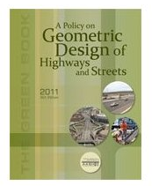
American Association of State Highway and Transportation Officials
AASHTO
The Green Book
First committee: 1937
First edition: 1954
Continuous updates
Local guidelines
Notes:
AASHTO is an organization made of representatives from all 50 states and has the responsibility of developing guidance for roadway design in the US. This guidance in reported in the Policy on Geometric Design of Highways and Streets, often nicknamed as the Green Book. The first edition of the guidelines was in 1954 and periodic reviews and updates to reflect current knowledge have resulted in the most recent edition of 2011. Older editions started as a collection of state practices and later research findings were incorporated as they became (or are becoming) available.
The goal of the Green Book is to provide guidelines for a safe and efficient roadway network system. Design guidelines often identify minimum acceptable design criteria that, if adhered to, are intended to provide a safe highway design. However, strict adherence to the minimum values may result in situations where the abilities of the driver will be stretched resulting in an unintended unsafe situation.

Slide 4
Guidelines or Standards?
Guidelines
  Recommended values
  Can be changed
Standards
  Fixed values
  Need to be applied
Notes:
The notion and differences between guidelines and standards need to be addressed here. Guidelines are recommended values that can be used as the basis for initial design and can be varied as needed to fit the context of the roadway. On the other hand, standards are established values that cannot be changed and have to be applied during the design process. If one considers the lane width as an example, the Green Book provides guidance as to the width to be used based on the functional classification of the road and allows the designer to select a value from a range (say 10-12 feet). However, for freeways, the lane width is viewed as a standard value of 12 feet and thus freeways have to be designed with 12-foot lanes.
An issue of concern is that many designers have viewed the suggested values of the Green Book as rigid standards instead of guidelines to be used in roadway design to achieve a reasonable degree of flexibility based on the roadway surroundings. This can lead to the erroneous assumption that the roadway will perform safely (see notes on nominal and substantive safety slide 8). Hauer examined the belief that adherence to design standards is directly linked to safe roadways and he found that design guidelines have an inherent safety level but there is little known of what will be the impacts of using flexibility in applying them in roadway design.
Hauer, E. Safety in Geometric Design Standards I and II, in Conference Proceedings of 2nd International Symposium on Highway Geometric Design, Mainz, Germany (2000).

Slide 5
Why Need Guidelines?
Share expertise
Common design aspects
Driver expectancy
Inter-jurisdictional travel
Notes:
The need to develop roadway guidelines stems from a variety of issues. The AASHTO Green Book represents the common wisdom and collective knowledge of the profession as it has been developing based on prior experience and research findings. The guidelines developed allow for sharing the up to date expertise on roadway design and other related issues, such roadside design and bicycle facilities, and form the basis for roadway design. Even though every state has the option to develop their own guidance, all agencies either adopt the Green Book as their guide or develop some additional guidelines aiming to simplify the process and assist their designers in developing solutions customized to their local issues. This approach ensures that there common design aspects throughout the country and promotes design consistency among various jurisdictions. The common guidance also allows for consistent driver expectations, especially for those traveling at different areas and jurisdictions.

Slide 6
Safety and Roadway Design
Each design assumes a safety level
Section 109, Title 23, USC
  Need for balancing of safety, mobility, economic considerations, protection and enhancement of natural environment, and preservation of community values
  Safety is not paramount over other considerations
Tradeoffs among design, cost, and safety
Notes:
It should be noted form the outset that each design assumes a safety level. The main goal of the final design is to achieve a “reasonable” level of safety & service. This is also noted in the Title 23 of the US Code, Section 109, where safety is one of the key features that needs to be addressed when developing a design and needs to be balanced against other competing project priorities.
Every design assumes tradeoffs among costs, safety and operations and this is done continuously consciously or unconsciously. Examples of such trade offs could be considered the following:
Safety vs Operational efficiency: Often right turn on red is allowed to improve operational efficiency at the expense of safety
Safety vs Budget: Divided highways are frequently safer than other roadways but not all roadways are constructed with medians.
6

Slide 7
Some Questions
What is a “safe” roadway?
Can we ever have a “safe” roadway?
Notes:
There are two basic questions on can ask at this point:
What makes a roadway safe?
The main focus of this question is to make the audience to identify elements that may make a road safe. Possible answers may be divided highways, wide shoulders and clear zones, straight roads, good pavement, roads with adequate capacity, and roads with no cars. This would play well in the next slide where each of these could be questioned.
2. Can we ever have a safe roadway?
The answer here is no. Even if we design a roadway to perfect dimensions, there are always elements that we can control including driver errors, weather conditions, and vehicular failures. What we are trying to do is design a roadway that will provide for reasonable safety and eliminate driver errors based on roadway failure.

Slide 8
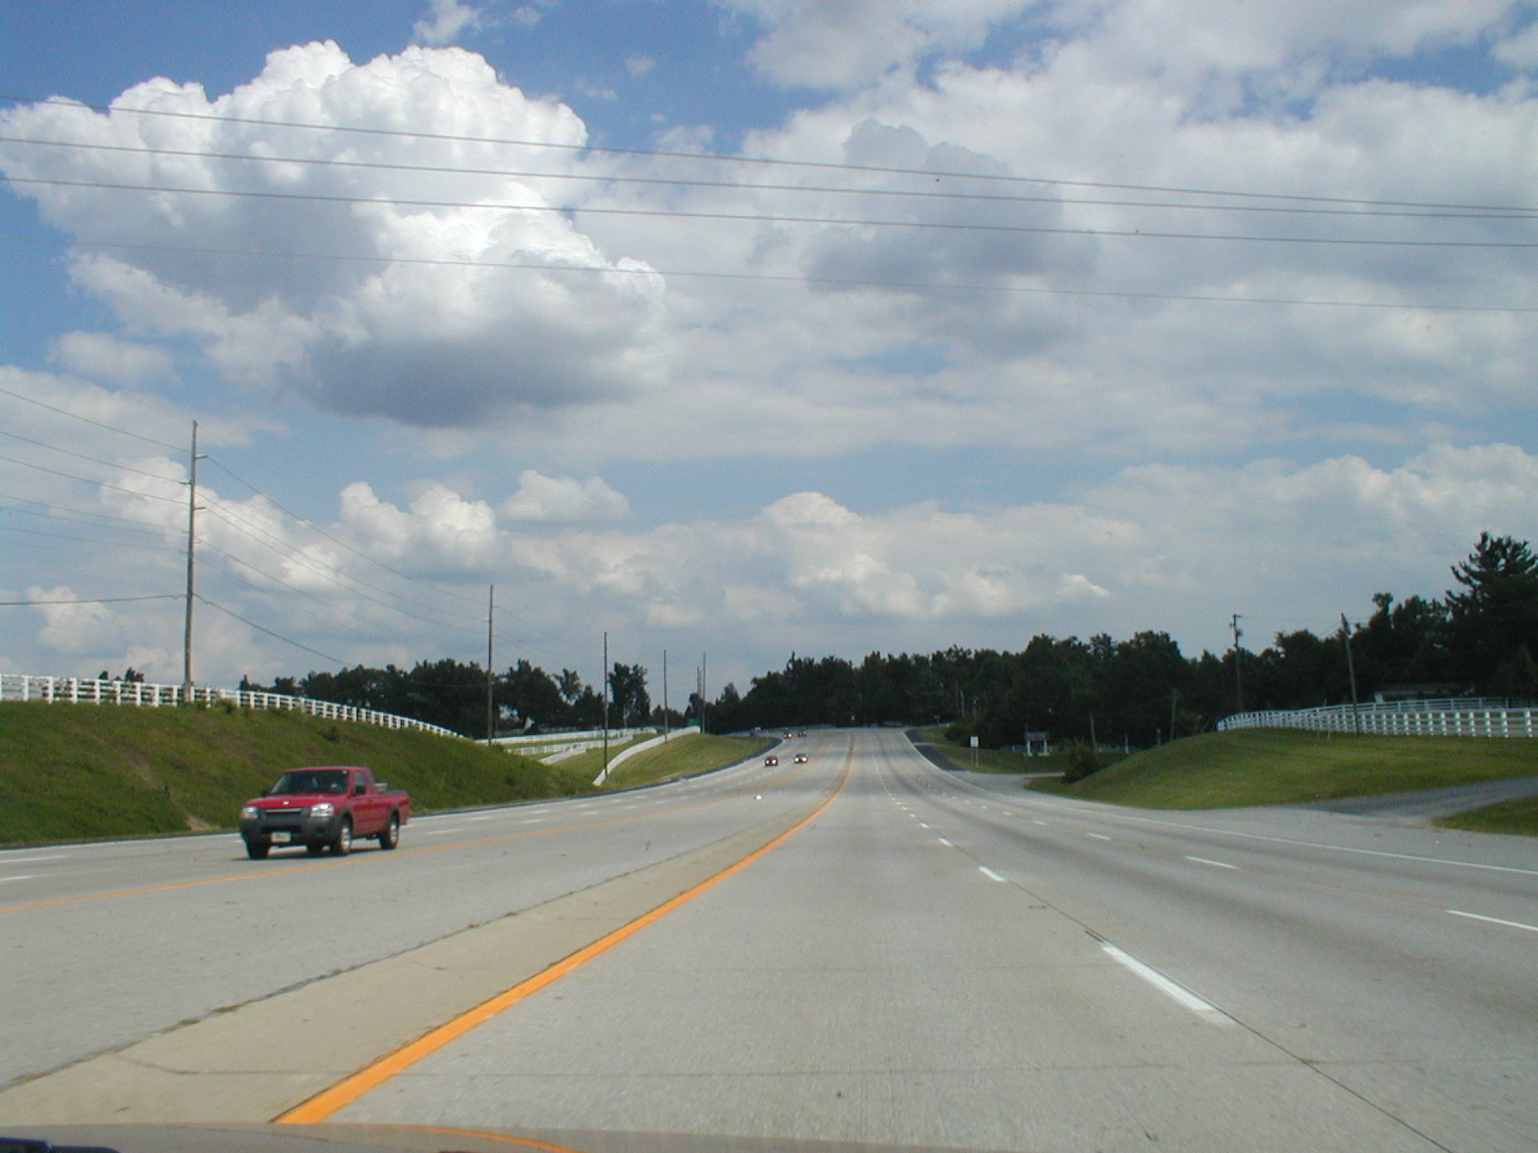
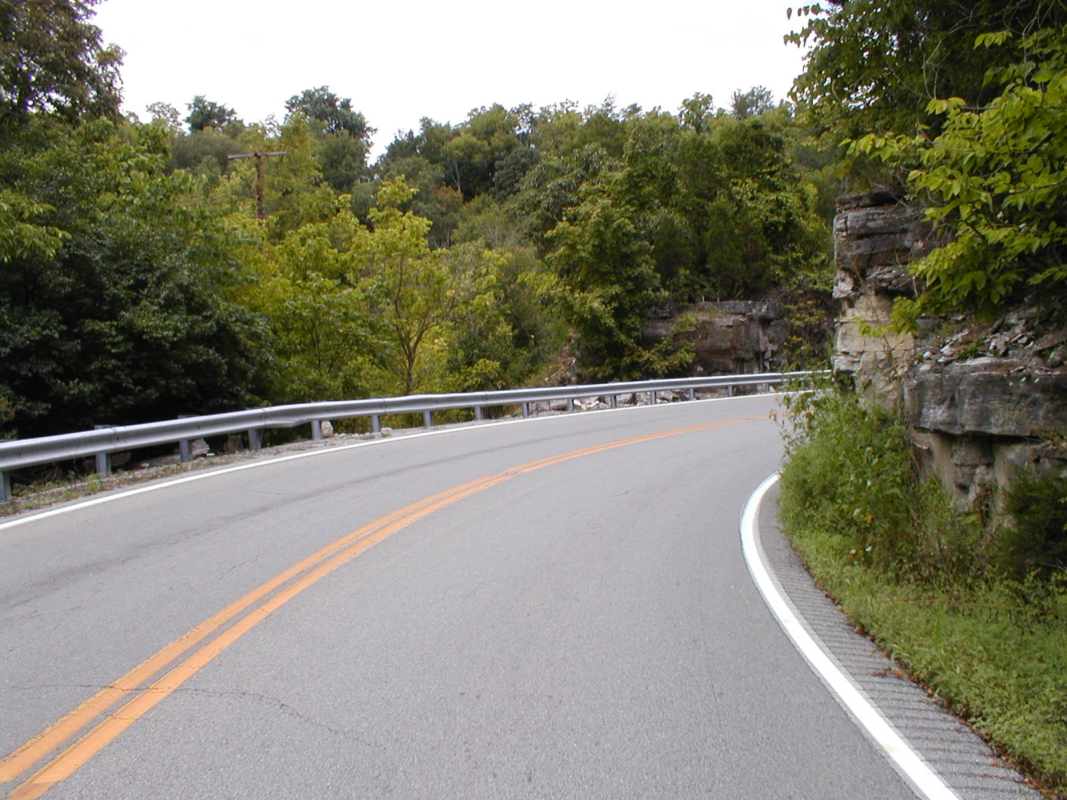
Safe Roadway?
Notes:
The first picture shows a 4-lane divided highway with wide lanes, shoulders and adequate clear zones. The question posed here is whether this is a safe highway. The second picture shows a 2-lane facility with narrow shoulders and obstacles 4 feet from the travel lane. The same question is posed here as well.
Question: Which of these two roads is safer?
Tying this with the questions in the previous slide, one may start considering the notion of a gray scale when determination of safety levels is considered. Possible questions from the audience could include: what is the crash rate for each section, what are the speeds for each section, and what are the traffic volumes. All these demonstrate the need for additional information to make the decision and the absence of a yes/no answer. The first segment has a crash rate of 62 crashes per 100 million VMT (24 crashes, AADT 35,000 over 3 years) and the second 61.5 crashes per 100 million VMT (2 crashes AADT 2950 over 3 years). Therefore, there are factors that one needs to consider when determining safety levels.

Slide 9
Safety Levels
Nominal safety
  Measured as compliance to standards, warrants and guidelines
  Yes/No
Substantive safety
  Measured by crash frequency and severity
  Continuous scale
Notes:
The previous discussion leads to the need for a different approach in roadway safety. According to Hauer, there are two levels of safety. The first, called nominal safety, identifies whether a system has been designed and constructed based on a set of criteria or standards. Compliance to the standards ensures safety and lack increases failure. An example of this could be the codes used for concrete and steel where lack of providing what the standards require (with respect to slab height or steel size and amount) will eventually result in a failure.
However, in roadway safety this is not the case. The fact that a roadway segment has been designed and constructed based on the guidelines (or standards) does not automatically ensure safety. In roadway, the concept of safety is called substantive that is based on the roadway’s actual safety performance measured along a continuous scale and is expressed in crash frequency and severity of crashes. This reflects the notion that incremental changes in geometric design element values will result in incremental changes of safety and thus providing a continuum instead of an absolute yes/no as nominal safety dictates.
Hauer, E. Safety in Geometric Design Standards University of Toronto, Toronto, Canada. 1999.

Slide 10
Which Side is Safer?
Section A
Section B
Notes:
Another aspect that should be noted regarding safety and determining the potential safety effects, especially when applying countermeasures, is the relative perspective of safety. Given the example above, both options could be viewed as viable alternatives but each could be considered different (or less safe) depending the users’ perspective. For the drivers, Section A is “safer” since there are no trees by the side of the road that an errant vehicle may hit. On the other hand, for a pedestrian, Section B is “safer” due to the presence of a buffer between vehicles and them. This is an issue that further complicates safety and introduces the notion of targeted evaluation and designs that may require a more detailed examination of multiple impacts for each user.

Slide 11
Tort Liability
Legal duty violation for which the law provides a remedy of monetary damages
KYTC responsibility
  Provide reasonably safe travel
  Duty to warn public
Sovereign immunity
Contributory v. Comparative Negligence
Ministerial v. Discretionary functions
Notes:
Tort liability stems from violations of the legal duties and could result in a punishment. Tort liability has been a controlling factor for highway designs in the past where designers were afraid to deviate from the guidelines. The belief was that designing a facility according to standards will absolve them from any liability. However, this is not the case and a more appropriate manner to address liability is the documentation of all decisions made throughout the project development process, maintenance of decisions records, and following a clearly defined process for reaching decisions (AASHTO 2004).
The Kentucky Transportation Cabinet’s responsibility is to provide reasonably safe travel and warn the public as needed. This could be viewed as an effort to provide an as safe as possible system that is properly signed to provide information about potential unsafe situations. Kentucky is a state with sovereign immunity, which implies that the state is exempt from suit and any liability (or in plain words, the state cannot do wrong).
There are also two levels of negligence:
Contributory: If the plaintiff contributed at all, then they are totally to blame
Comparative: If the plaintiff contributed, then they are responsible for the percentage of blame assigned to them.
A Discretionary Function is defined as “one which requires exercise in judgment and choice and involves what is just and proper under the circumstances.” A Ministerial Function is defined as “that which involves obedience to instructions, but demands no special discretion, judgment, or skill.” (Black 2009).
AASHTO A Guide for Achieving Flexibility in Highway Design, 2004.
Black’s Law Dictionary, Ninth Edition, 2009

Slide 12
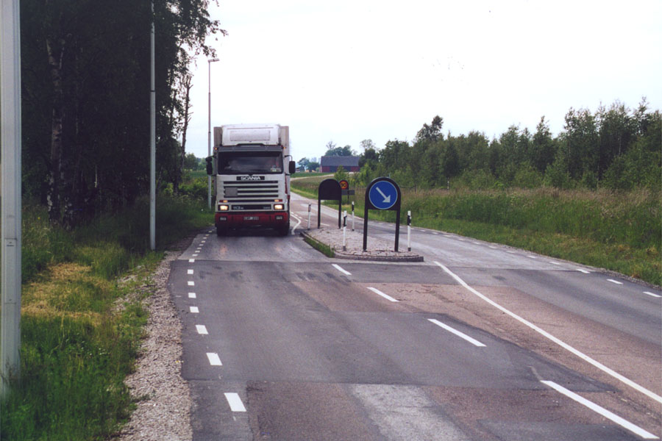
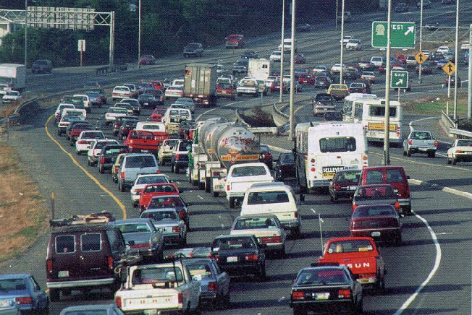
Design Controls
Design vehicle
Design speed
Design volume
Notes:
There are a number of elements that a designer needs to deal with and those control the final design developed.
Design vehicle is defined as the largest expected vehicle to use the roadway with considerable frequency. Physical and operational performance characteristics of the vehicle affect several elements of design (such as radius, grades, underpass clearance, driver’s eye height, etc.). Selection is based on the context of the roadway and location and designers are urged to select a vehicle that represents a cost-effective choice for the project. For example, in an urban setting selecting a bus as a design vehicle instead of a semi-trailer (even if those can be seen on the road) may be more appropriate due to potential impacts on sidewalks and buildings and properties adjacent to intersections.
Design speed is probably the most fundamental input to design. The current Green Book approach establishes most of the dimensions of the various design elements based on design speed and thus its selection affects all design aspects. Traditional practice has been the development of designs with as high a speed as possible. This conforms to the idea of high mobility but may be at the expense of safety. i.e., higher speeds may result in more crashes. The choice should be based on the context of the roadway, the intended operating speed, and the vehicular and non-vehicular traffic.
Design volume defines the amount of traffic to be accommodated in the facility. Research has shown that traffic volume is the single greatest contributor to the risk of a crash. An issue of concern here is that a facility is designed based on future traffic and as such it may not be a very accurate estimate of traffic demand. The design volume has implications on the size of the roadway, since each design aims to accommodate traffic at a certain operational level. Balancing costs with safety and community needs is central in utilizing design volumes during the design process.

Slide 13
Cross Sectional Components
Travel lanes
Auxiliary lanes
Shoulders
Medians
Clear zones
Notes:
Various roadway components could impact safety and their implications are presented here:
Travels lanes: this deals both with the number of lanes as well as their width. Typically, wider lanes are associated with higher speed roadways and in general, wider lanes are safer than narrower lanes (HSM 2010). However, lane widths should be balanced though a cost-benefit analysis where the benefits from reduced number of crashes need to be evaluated against the cost of wider and more lanes.
Auxiliary lanes: their presence at intersections has shown to improve safety (HSM 2010). The advantage is that they remove the turning traffic form the mainstream and allow for completing turning maneuvers as the drivers see fit.
Shoulders: this deals both with the shoulder type and width. Typically, wider shoulders provide more room for drivers to correct any mistakes especially in situations where they run off the road. Similarly, paved shoulders have shown better safety performance than unpaved shoulders. The choice of width and type should be based both on anticipated safety performance as well its function (AASHTO 2004).
Medians: this deals with median width and type as well. Medians provide for the separation of traffic and their presence has a positive safety effect, since it can reduce crossing over the opposite side of travel (HSM 2010). Median width should be balanced against other roadway elements and right of way requirements. Selection of median barrier type (if used) is also critical due to the addition of an element that can affect safety severity (concrete barriers are less forgiving than cable barriers).
Clear zones: this mainly deals with the width provided beyond the end of the travel lanes. Keeping the adjacent are free of obstacles is essential in order for errant vehicles to avoid hitting them. This is another element where costs (right of way) need to be balanced against potential safety issues and appropriate remedies (removal, relocation, modification, shielding and delineation).
Current research efforts examine the combined effect of these treatments to determine what these implications are, i.e., multiplicative or additive, or which of these factors may be the most critical for highway safety.

Slide 14
Design Exceptions
Policy and guidance deviation
13 Controlling elements
  Design speed
  Lane, Shoulder, Bridge widths
  Vertical, Horizontal alignment and clearance
  Super
  Stopping Sight Distance
  Structural capacity
  Cross slope
Justification
Notes:
Design exceptions are a process utilized by state transportation agencies when there is a need to develop roadway designs that require deviation from the prevailing guidelines and policies. Designers rely on design guidelines and policies, which aim to address safety, mobility and economic goals. Sometimes, however, it may not be practical to conform to all these guidelines. For example, it is possible that adherence to a certain geometric specification may create environmental implications, affect historical structures, be economically unfeasible or affect a community in an undesirable way. In these cases a design exception can be used to address these deviations.
FHWA has identified 13 design elements that are considered appropriate for consideration when design exceptions are requested. These include cross sectional elements, such as lane and shoulder with, cross slope and bridge width, alignment concepts, such as vertical and horizontal alignment, superelevation, and vertical and horizontal clearance, and stopping sight distance and structural capacity. It should be noted here that these are the criteria that FHWA requires a formal process for requesting deviations from the guidelines of projects in the National Highway System (NHS) and it does not preclude the need to alter other design elements if such deviations from policies are needed.
Design exceptions require a formal process where the need for the deviation is identified and explained. Most states have developed a form that identifies required and proposed values for the elements to be altered and require a short write up to justify the need for the exception. Recent efforts have also included the need to attempt an estimate of the potential impacts of the design exceptions where safety, operational, and economic impacts need to be identified.

Slide 15
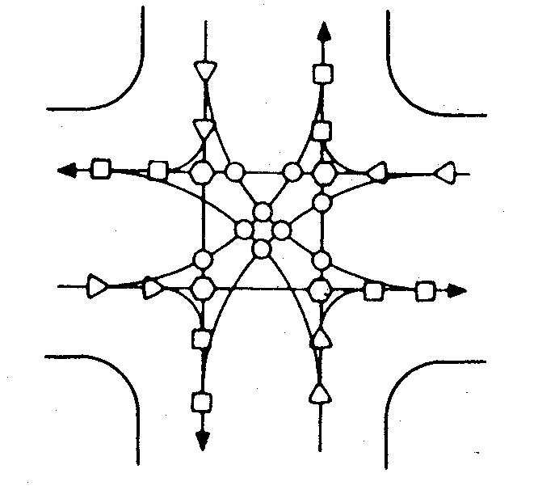
Intersections
Without signal
Notes:
Intersections are the most complex roadway element because it requires roadway users to make simultaneously multiple decisions. The user needs to be aware not only of the traffic next to them but also traffic coming from all other directions as well as traffic controls that could pose restrictions to their movements. A typical 4-leg intersection controlled by a stop sign has 32 points of potential conflict (places where streams of traffic cross paths) as opposed to three or four conflict points on an access controlled highway. Left turns at an intersection are the most difficult maneuver (16 of the 32 points are left-turn related) and as such efforts to improve safety have concerted in the use of signalization (protected left turn phases) and presence of exclusive left-turn lanes.

Slide 16
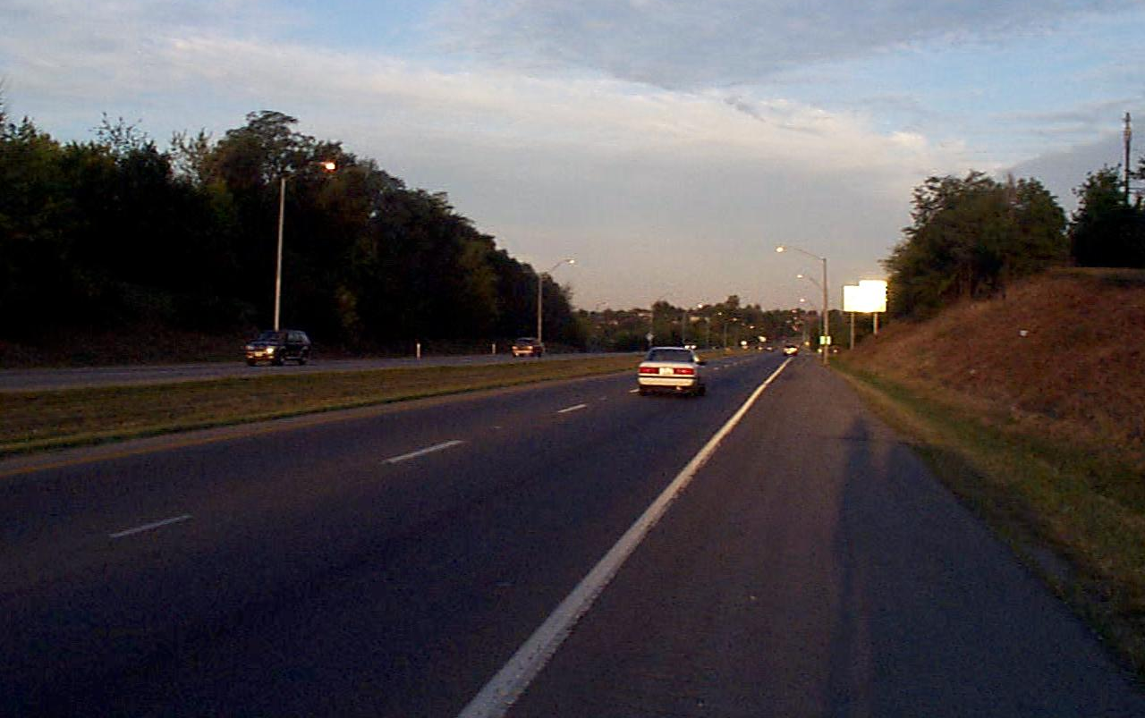
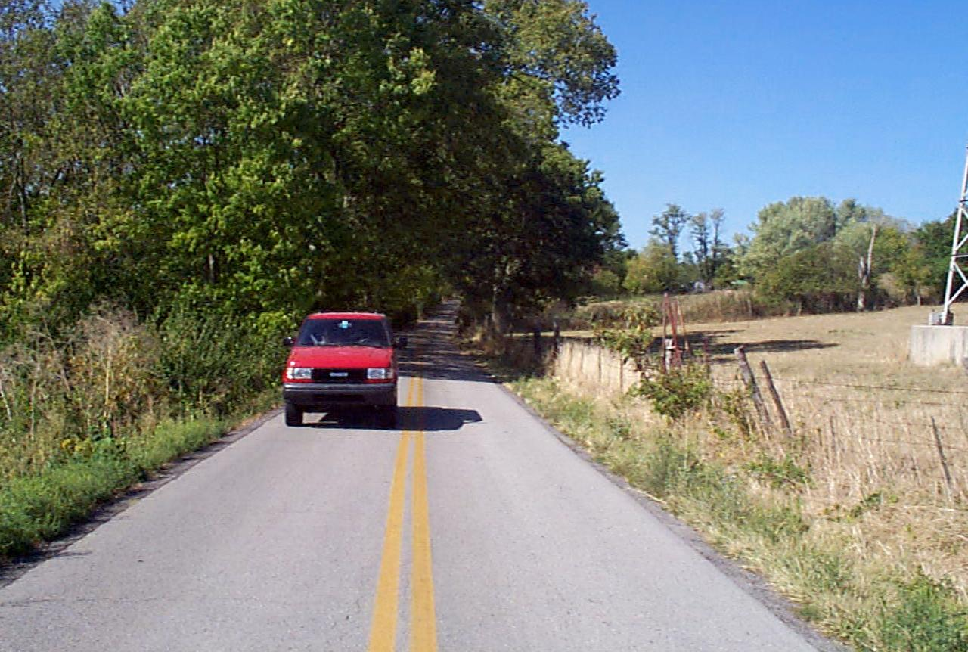
Driver Expectations and Design
Roadways which look-alike should also “drive” alike
Use of uniform nation-wide guidelines
Notes:
Drivers form expectations of a roadway with respect to how to drive on it based on their visual cues. The notion that roads that look alike should also drive alike is paramount in providing a safe environment. For example, the road in the left picture gives the impression that it can be driven safely with high speeds due to the wide lanes and shoulders and presence of a median. In this case it looks like a high-speed facility and the driver expects to be bale to drive it as such. On the right side, the restricted cross section indicates the need for lower speeds and the driver should conform to the road environment and adjust speeds accordingly. Problems may arise when the way the road looks does not coincide with the manner with which drivers can drive. For example, a very sharp curve on the left picture is not expected and it may lead to unsafe operating speeds, while a sharper curve could be easier negotiated in the right picture due to presumably lower speeds. The use of the uniform nation-wide guiltiness aids in this aspect.

Slide 17
Design Consistency (1/2)
Uniform design speed
  Roadway appearance may be deceiving
  Long tangents followed by curve
Compatibility of geometry and operating requirements
  Speed transitions
Notes:
Design consistency is central to roadway design and safe performance. The notion of using the same design speed throughout the roadway does not guarantee that the roadway has been designed in a consistent manner. The ideas noted in the previous slide about driver expectancy have an immediate application here. Roadway appearances may be deceiving and provide drivers with a false sense of security and operating performance. For example, long tangents followed by sharp curves are not considered a good and safe design practice and as such should be avoided. Another element that needs to be considered is how one transitions from one element to another (for example from a straight segment to a curve). Current models allow for the estimation of the speed differential in such transitions and provide values that render them unacceptable and unsafe requiring attention to be paid in such locations.

Slide 18
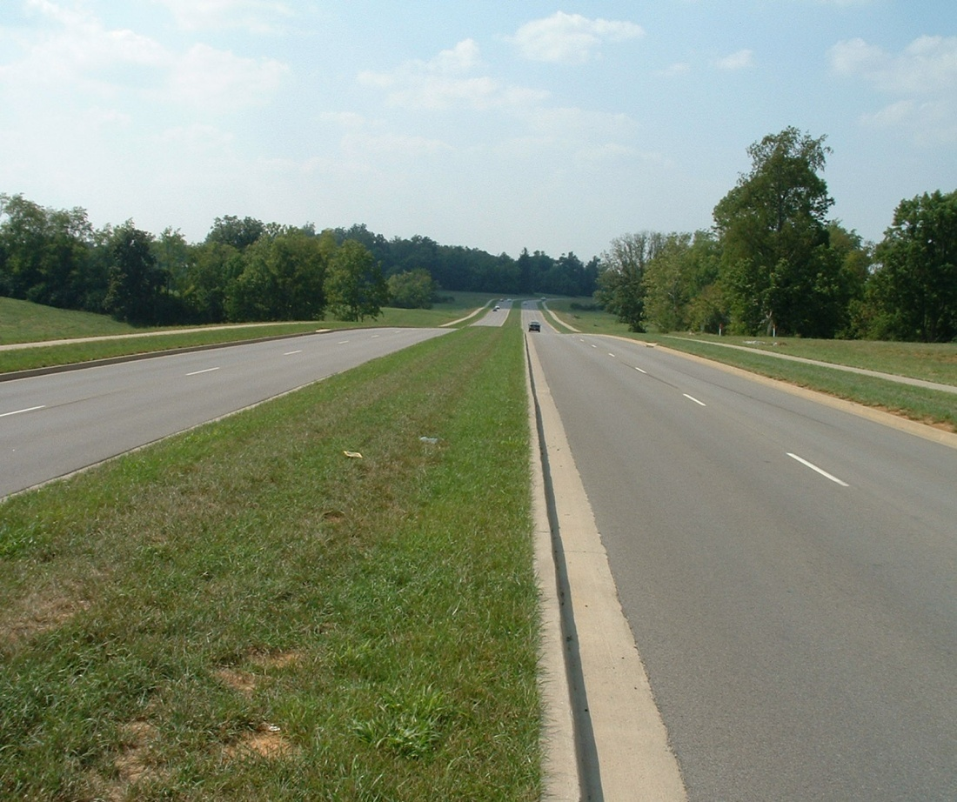
Design Consistency (2/2)
Notes:
This picture highlights the concept of design consistency. The preceding tangent was designed at 45 mph and the posted speed limit was also 45 mph. At the far end of the road shown here there is a fairly sharp curve (deflection angle of 100º). Driver operating speeds at the leading segment are fairly high resulting in unexpected braking when approaching the curve. Signing is not very helpful (or effective given the tendency of drivers to misunderstand or ignore signing due to proliferation of warning signs) and safety concerns have been raised at this location requiring some remedy.

Slide 19
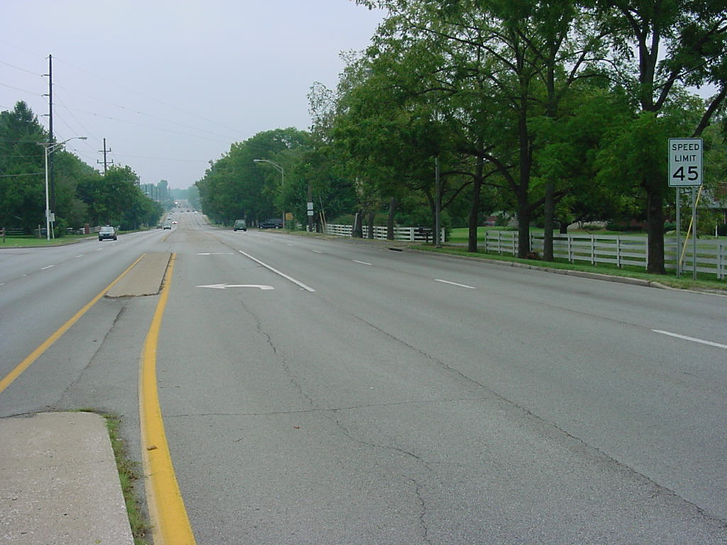
How we Communicate Safety (1/2)
Notes:
The picture shows a 4-lane divided roadway segment with a 45 mph speed limit with curb and gutter in an urban area. The roadway conveys an image of a fairly open roadway where speeds can easily exceed the posted speed limit. The driver perceives that there is ample space to correct any mistakes and thus can drive at speeds that feel comfortable and may exceed the posted speed limit.

Slide 20
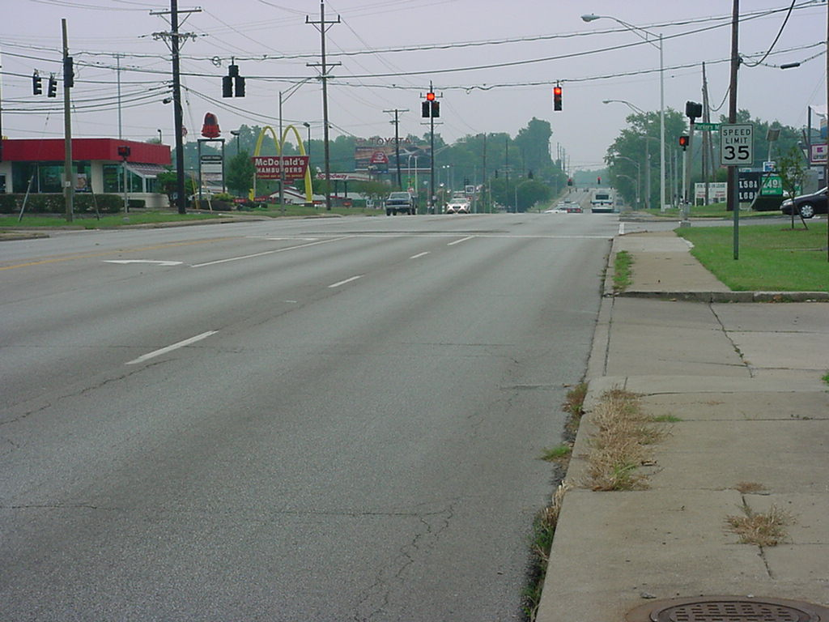
How we Communicate Safety (2/2)
Notes:
This is a location less than 2,000 feet away from the previous picture. The speed limit has been changes to 35 mph without any additional changes to the cross section that may encourage drivers to reduce their speeds. This is also a similar phenomenon noted in transitions from high speed rural to built up areas where we rely on posted speed limit signs to change the operating speeds. As noted above, reliance in signs to enforce speeds and inform drivers may need to be revisited, since drivers tend to ignore them.

Slide 21
Self-Explaining, Self-Enforcing
Basic concept
  Operating & design speeds
Use of roadway elements to affect operating speeds (in Europe)
Friction concept
Landscaping and safety
Notes:
A new idea is taking root mainly in Europe for developing roads that are self-explaining and self-enforcing. The concept was initiated in Europe (Denmark, Netherlands and Germany) and its focus is on developing a roadway design consistent with desired operating speeds. The self-enforcement part of the design comes from the introduction of design elements that will prohibit the user to exceed the desired operating speed.
The concept applied here is that of friction among the various users that could result in slower speeds and allow for target operating speeds. An additional benefit of the lower speeds is the lower severity levels of crashes, since crashes will occur at lower speeds. Landscaping, especially trees, has long been viewed as a roadside obstacle and a detriment to safety. Trees adjacent to the roadway can pose such a safety concern but at the same time can be an issue with communities and stakeholders and thus their location and placement needs to be viewed under this scope. Using low shrubbery can provide for a separation between vehicles and pedestrians and tat the same reduce the severity of the potential impact from errant vehicles.

Slide 22
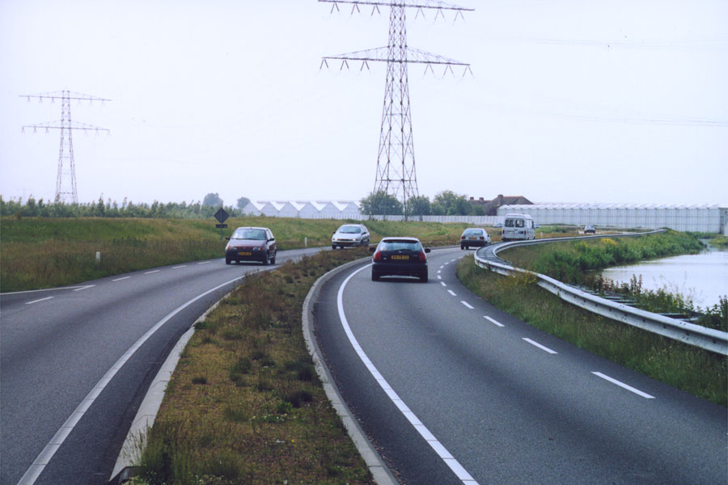
Self-enforcing, Self-explaining
Notes:
This is an example of a self-enforcing, self-explaining roadway in the Netherlands. This was originally a 2-lane, 2-way facility retrofitted with a median to address head-on collisions, a wider overall paved section where lanes were narrowed form the original width but with some additional shoulder, and pull off areas to allow for passing. The narrower lanes encourage lower speeds, since drivers attempt to keep the vehicle within the edge lines, thus enforcing the desired lower operating speeds, i.e., self-enforcing. The horizontal curvature and the median provide for the self-explaining part limiting passing and dictating also lower speeds.

Slide 23
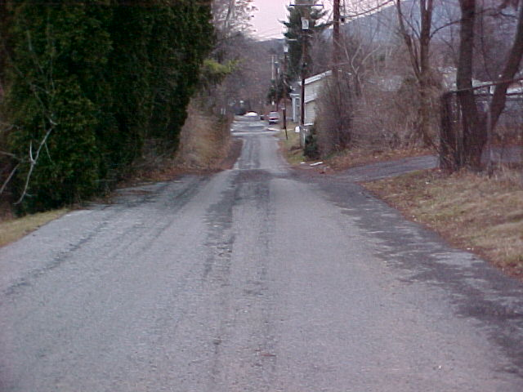
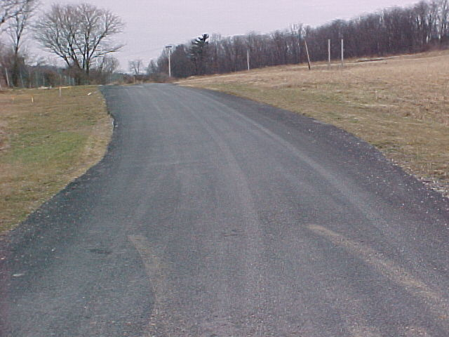
Operating Speeds (1/2)
Notes:
Question: In which roadway section will you drive faster and why?
Answer: the most probable answer is the right, since the open terrain does not prohibit drivers to reduce their speeds. Both roadways have the same pavement width, approximately 20 feet. The presence of trees and other elements by the side of the road in the left picture would result in slower speeds than those in the right side.

Slide 24
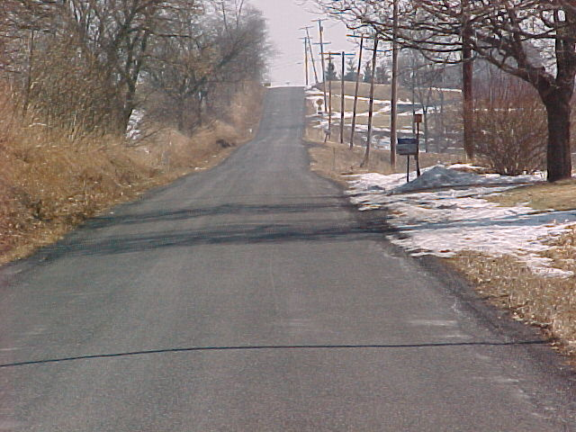
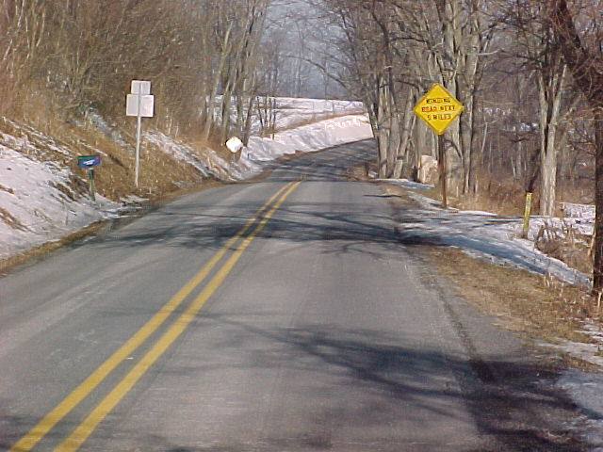
Operating Speeds (2/2)
Notes:
Question: In which roadway section will you drive faster and why?
Answer: the most probable answer is the right, since the presence of the centerline markings delineate the proper vehicle location and provide for a sense of security, i.e., stay within the lines and it will be OK. Both roadways have the same pavement width, approximately 20 feet. The lack of centerline striping creates some ambiguity and could result in lower speeds due to driver uncertainty for placing their vehicle in the right spot.

Slide 25
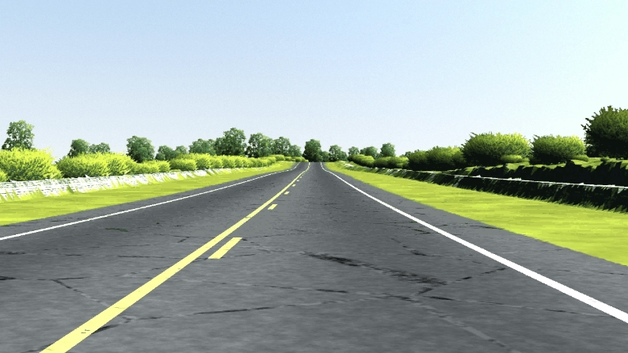
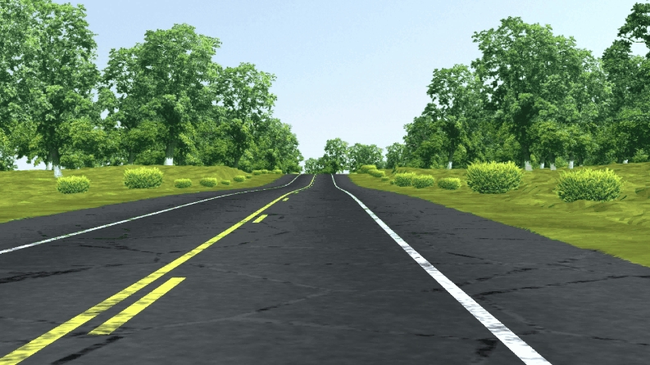
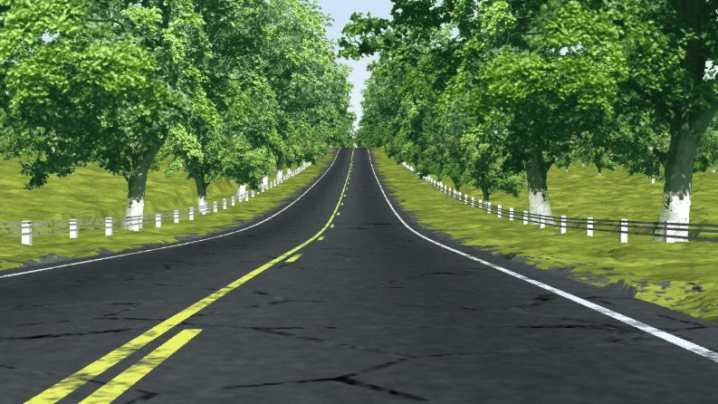
Roadside Type and Speed
Stamatiadis et al., 2010 TRR 2195
Notes:
A recent study examined the effects of altering the roadside elements type and proximity to the road on the operating speeds. The objectives were to identify elements or features of the roadway environment that could influence drivers’ operating speed through visualization animations and the use of fuzzy set analysis for modeling.
The study examined the effects of roadway width (<16, 16-19, >16 ft), horizontal curve radius (500, 750, 1000 ft), vertical grade (Level, Rolling, Mountainous), plant density (Grass, low plants, shrubs, trees), and barrier type (None, cable, steel, wood, stone, rock wall). Some sample scenarios are shown here.

Slide 26
Roadside Type Impacts
Higher discomfort for increased
  Vegetation height
  Barrier presence and stiffness
  Horizontal curvature and barrier or vegetation
Higher discomfort for decreased
  Roadway width
Interaction among vegetation and roadway width
Notes:
The results of the study indicated that there is an influence of the plant density on the driver’s discomfort, i.e. operating speed, which could be used in roadway designs aiming to influence these speeds. The plant intensity showed some influence that was more apparent for narrower roadways with narrower clear zone widths and for roadways with sharper horizontal curves and low grades. The results showed that discomfort increased with narrower roadways indicating the potential for impacting operating speeds by adjusting roadway width according to the desired speed.
The results of the study indicate that the use of vegetation type and density and barrier type has the potential to influence driver operating speeds. These roadside features can be used in designing roadways aiming at achieving desired operating speeds. The results show that discomfort increases when trees are present or when guardrails are added. It is therefore possible to envision that the placement of such devices will have an effect on operating speeds, i.e. reduce them.
Stamatiadis, N., Baily, K., Grossardt, T, and Ripy, J. 2010 “Evaluation of Highway Design Parameters on Influencing Operator Speeds through Casewise Visual Evaluation”, Journal of the Transportation Research Board, Record 2195, pp. 143-149.

Slide 27
Traffic Control Devices
Basic principles
  Locate signs in advance of action point
  Inform the drivers not surprise them
  Provide redundant information
  Avoid areas with high mental work load
Notes:
Traffic control devices assist drivers in anticipating and reacting properly to unexpected elements as well as aid in their proper placement and assignment of right of way. These devices need to be placed properly and well in advance of the action point and they need to provide adequate information to the road user to properly react to the situation. For example, a curve warning sign needs to be placed well in advance of the curve to provide the driver with adequate time to adjust speed and negotiate the curve appropriately. The devices should also provide redundant information to ensure compliance with the desired action. In the curve example, a second sign prior to the curve may be used to emphasize the proper speed for taking the curve or the warning sign may be coupled with chevron arrows that delineate the curve. The devices need to be placed at locations where drivers are not overloaded and typically they should be placed in a manner requiring the driver to make one decision at a time.

Slide 28
Traffic Signs
abc
abc
abc
Guidance
Warning
Work Zone
Prohibition
abc
abc
abc
Regulation
Driver Amenities
Recreation
Notes:
Signs have associate shapes and colors to indicate appropriate information.

Slide 29
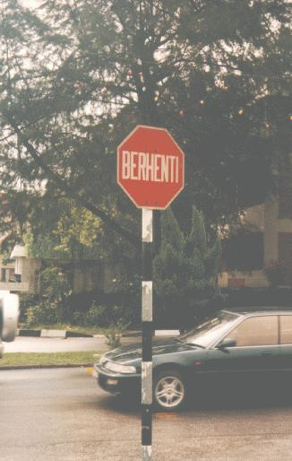
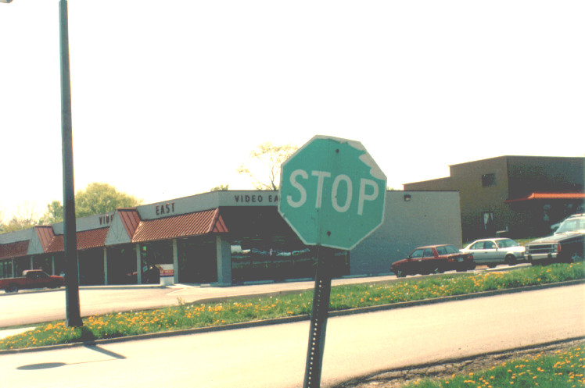
Shape & Color?
Notes:
Drivers associate shape and color of the sign with a priori knowledge. For example, red octagonal signs are always associated with a STOP sign and lack of language understanding the word in the sign can be overcome with the basic shape and color. On the other hand, shape by itself can also provide the basic message even if the color is not the correct one (as the case in the right side picture).

Slide 30
Good Highway Design
Use
  Long sight distances
  Smooth curves
  Consistency
  TCD's only to inform
Remember
  Drivers make errors
  Need room to correct them
Notes:
Good highway design utilizes a series of principles that rely on providing adequate sight distance and avoiding surprises to the driver. Alignments that allow for drivers to see ahead and anticipate situations are preferred to those with limited sight distance and other obstructions. Design consistency and ability to transition between elements without significant speed changes are also essential. Traffic control devices should be used sparingly and only to inform the driver rather than impose operating speed. Drivers tend to ignore warning signs due to sign proliferation and this may be detrimental when the signs need to be adhered to.
One needs to never forget that in any roadway, drivers will make mistakes and there should be adequate space to correct any error. The concept of the clear zone is central to a safe highway but this needs to be examined within the greater scope of a benefit-cost analysis where construction costs are to be evaluated as a function of the safety benefits gained.

Slide 31
Future Problems
Vehicle size
Vehicle numbers
Highway funds
Notes:
Over the past decades there have been significant changes in the vehicle fleet that have affected highway design and safety. The trends of bigger automobiles (pick up trucks and sport utility vehicles) required the consideration of wider lanes and superelevation rates on ramps (stability of sport utility vehicles). Performance characteristics also change and these have to be accounted for in the highway design. The larger number of vehicles and the associated congestion could affect safety. Studies have shown that congestion increases the number of crashes, simply because there are more vehicles in the road. At the same time, continued roadway widening is not feasible and therefore alternative solutions should be sought. Funds for highway construction have been reduced in the last decades, resulting in the need to address safety and mobility issues in a more critical manner. This has introduced the notion of cost-benefit analyses where the costs of the improvements need to be balanced by the safety gains.

Slide 32
Question of the Day
Can safety be improved with design?
Notes:
Question: Can we improve safety with design?
Answer: Up to a certain extent, since the deign can address roadway deficiencies but cannot deal with driver, vehicle or environmental issues.

