Slide 1
STATISTICS REVIEW
Copyright © 2016 STC, UK
Notes:
This module reviews fundamental statistics related to safety analysis. It is critical to have a basic understanding of the models to be developed in order to apply the statistical methods and tools correctly for safety analysis. Even though current highway safety analysis techniques have moved beyond basic statistics, an understanding of statistical fundamental concepts can be useful in any analysis.

Slide 2
Basic Questions
What to measure?
Number of crashes
Effectiveness of a measure
Is change due to
Randomness?
Treatment?
Notes:
There are two basic questions that one has to deal with when concerned with statistical analysis in highway safety. The first deals with the identification of the safety measure to be evaluated. A metric of interest could be the level of risk expressed as a number of crashes at a particular location, for a particular group of drivers or for a specific crash type and level of severity. Another metric could be the relative effectiveness of a countermeasure as it relates either to the existing conditions or as compared to other countermeasures.
Another fundamental question for highway safety is the identification of whether the resulting change observed is due to randomness of the treatment implemented. It is possible that a change in crashes (or safety level) is completely due to randomness, since crashes are random and rare events. Moreover, crashes have shown to vary with time and there is a phenomenon called regression to the mean, where data fluctuates over time around its true mean. It is therefore imperative to be able to distinguish whether the change would have happened with or without the treatment implemented.

Slide 3
Safety Evaluations
Before and After
Cross-Sectional
Hazardous locations
Multivariate crash models
Notes:
Before and after evaluations compare the safety performance of an improvement through an examination of the safety performance before and after the intervention. The information can be used to guide future safety improvements. These evaluations can be simple before/after, with or without control sites studies or take the form of more complicated empirical Bayes (EB) approaches. A major issue with this approach is the fact that simple (naïve) before/after do not account for other factors hat could have an influence on the changes observed and need to separate them from the improvement effect. These factors include traffic volume changes and random fluctuation in accident counts (also known as regression to the mean that will be discussed later).
Cross-sectional evaluations aim to estimate the safety effects of various possible improvements. Simple approaches include the evaluation of crashes considering other factors to determine whether a specific treatment had an effect while considering several locations with and without the treatment. More complicated approaches can take the form of regression models using a variety of highway features, including traffic volume and then can estimate the safety effect of making a change in one or more variable using the equation to calculate the resulting change in crashes.
Identification of hazardous locations is a process through which locations are ranked based on their safety record to identify those that should be investigated for safety deficiencies and possible treatment of these deficiencies. The process is sometimes known as “blackspot identification” or “identification of sites with promise”. An important issue here is the proper use of a method to identify the sites, since simple crash rates or number of crashes may suffer from the random fluctuation of crashes.
Multivariate models are regression equations that relate crash experience to the traffic and other characteristics of locations to develop a prediction for crashes or understand the causation of factors contributing to crashes. In prediction models, the safety of a location is estimated as a function of variables that are deemed to be the best predictors while in causation models, crashes are related to factors that could explain crash causation and the coefficients of the various factors can be used to estimate the change in safety that would result from a change in that factor.

Slide 4
Terminology
Population
Sample
Descriptive statistics
Parameter vs. Statistic
Notes:
Let’s refresh our memory with some basic terminology in order to be able to understand the terms to be used in this section.
Population refers to the entire universe of a particular group. For example, if one wanted to know the average number of points per licensed driver in Kentucky for the entire population, she needs to account for every single driver.
Collecting population data can be a cumbersome approach and hence the concept of a sample has been developed. With the same example in mind, now the researcher can identify a smaller group of licensed drivers and consider this a representative sample of the licensed drivers in Kentucky. Note that there are certain rules and guidelines as to how one may develop this “representative” sample that is beyond this basic review (please review statistical procedures for this).
Descriptive statistics are the metrics used to describe a population or a sample. In this example, such statistics could include the average number of points, the standard deviation, the average age of the drivers and so forth.
Parameters and statistics are descriptors of a group characteristic. The difference is that parameters describe the population while statistics describe a sample. In our example, the statement “the average number of points per driver is 2.5” is a parameter if it is based on the entire population and it is a statistic if it is based on a sample of drivers.

Slide 5
Data Descriptors
Mean
Average number of distribution
Median
Middle point of a distribution
Mode
Most frequent number in a distribution
Variance
Notes:
The differences between these three terms. Each describe a statistic of a sample and can provide meaningful information about the distribution. Medians and modes are not sensitive to outliers of the data and sometimes may be more accurate descriptors of the data at hand.
The variance is a measure of dispersion of the data. It is estimated by averaging the squared distance of the values form the expected value (mean).

Slide 6
Data Descriptors Example
Consider the following speed measurements:
45, 46, 51, 45, 48, 39, 46, 52, 43, 44
Mean Median
Mode Variance
45.9 mph 45.5 mph
45.0 mph 14.3 mph
Notes:
As an example, consider the following speed data collected for a roadway segment. 45, 46, 51, 45, 48, 39, 46, 52, 43, and 44.
In this case, one can estimate the average speed of the distribution as 45.9 mph; the median to be 45.5 mph; the mode is 45 mph; and the variance is 14.32 mph.

Slide 7
Poisson Distribution
Discrete variable distribution
Probability of event occurrence
Models
Crash data at a single site
Vehicle arrivals at a point
Mean = Variance
Notes:
Poisson distribution is a discrete probability distribution that expresses the probability of events occurring in a fixed time assuming that the average rate of occurrence is known. The distribution also assumes that each occurrence is independent of the time since the last event. The distribution models the probability of the exact occurrence and can be used to model various elements in highway. Most typical uses are crashes at a single location and number of arrivals at a highway point (intersection arrivals within a cycle length). The distribution has only a single parameter to be estimated since its mean is equal to its variance.

Slide 8
Negative Binomial Distribution
Discrete variable distribution
Models
Crash data at several sites
Notes:
As noted in the previous slide, the Poisson distribution can be used to model crash counts at a given location. The Poisson distribution has been shown to be reasonable to model crash data at a given one site. However, one often wants to evaluate more than one locations and in this case the crash data will often exhibit a large variance and a small mean, and display over-dispersion with a variance-to-mean value greater than one. To address this issue, the negative binomial distribution, also known as the Poisson-Gamma distribution, has become the most commonly used probabilistic distribution for modeling crashes. The negative binomial distribution is considered to be able to handle over-dispersion better than other distributions and has been widely used in many fields in addition to transportation.

Slide 9
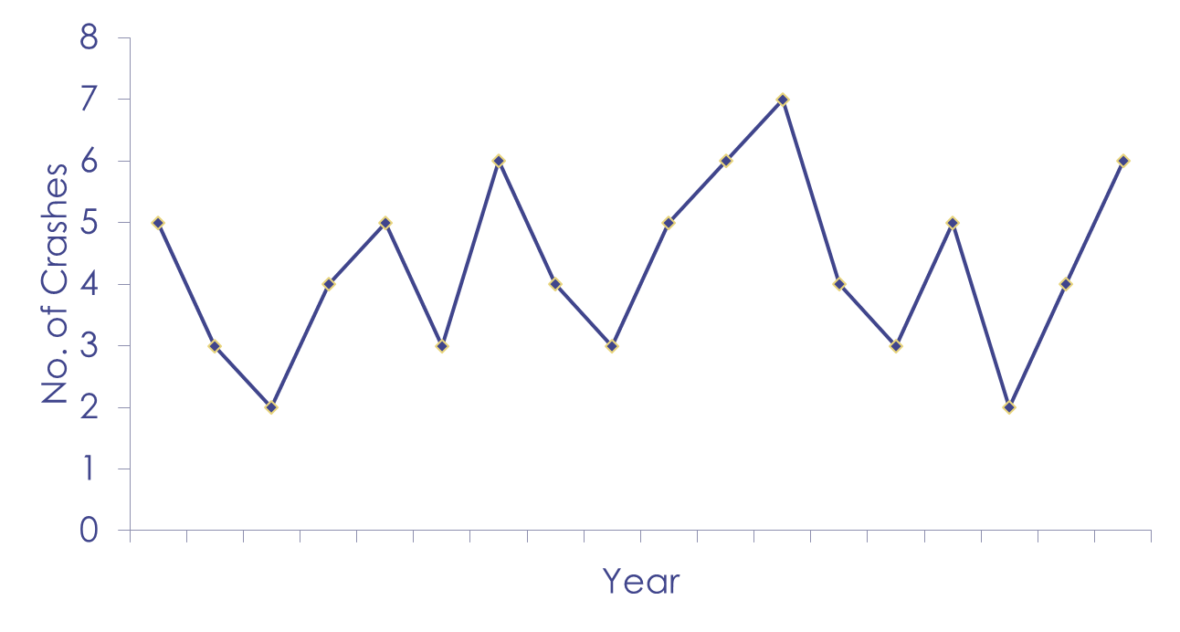
Regression to the Mean (RTM)
Notes:
Crash frequencies vary naturally from one time period to the next and therefore, a site that has an above-average crash frequency one year is likely to have a below-average crash frequency the next. This phenomenon is called “regression to the Mean” and is observable in various scientific fields (first was introduced by Sir Francis Galton in 1887 who was studying pea genetics and observed that large peas will produce smaller peas and small peas will produce large ones). It is a statistical phenomenon resulting from repeated observations of the same subject occurring with random error around a “True Mean”. Statistical methods can be used to assure that these changes are not mistaken as the effects of roadway enhancement project.

Slide 10
How to Address RTM
More data from similar sites
More years of data
Empirical Bayes
Notes:
There are a couple of possible ways to address the regression to the mean issue identified before. One approach is to include more data from similar sites, since there are a number of sites that could have a low number of crashes. This may skew the data to sites with no problems and thus represent an inaccurate picture of the safety situation. Another approach would be to increase the number of years considered in the analysis. This could be problematic as well, since a longer period may include other factors that may influence crashes. For example, consider the effect of an oil crisis that could affect the amount of travel and the potential influence that it may have on crashes. Moreover, both approaches need to consider the change in traffic over time and across sites and this could be problematic for large data sets.
Recently, the concept of Empirical Bayes approach has been used to address the RTM phenomenon (Hauer 1997). The objective of the approach is to estimate the number of crashes that would have been expected in the after period had there been no treatment.
Hauer (1997) Observational Before-After Studies in Road Safety, Pergamon.

Slide 11
Empirical Bayes Method
Conditional probability
Number of expected crashes
Weighted average estimate based on
Crashes at site
Crashes from other sites (prediction)
Notes:
The Empirical Bays method is an approach utilizing empirical data to evaluate or estimate the conditional probability of an occurrence and it is based on the Bayes Theorem, which describes the probability of an event based on conditions that might be related to the event. The objective of the approach is to estimate the number of crashes that would have been expected after the implementation of the treatment had there been no treatment. The difference between this estimate and the number of crashes actually recorded after the treatment is the estimate of the treatment effect.
The estimated number of crashes is obtained through a weighted average from two sources: 1) the number of crashes before the treatment at the location of concern; and 2) the number of crashes at other locations with similar traffic and physical characteristics based on the prediction model developed.

Slide 12
Basic Equations
N = N₁ w + N₂ (1-w)
where: N: estimated expected crashes
N₁: crashes from other similar sites
N₂: observed crashes at site
w: weight factor
w = 1/[1+(N₁ Y/)φ]
where: Υ: timeframe in years for crash counts
φ: overdispersion parameter
Notes:
The basic equation form is as shown above. The weights assign the relative importance between crashes from other similar sites (the population in this case) and the specific site where the treatment was implemented. The key here is to determine the weight to be associated with crashes in similar sites (N₁) and the Highway Safety Manual (AASHTO 2009) has defined this a function of the crashes from other sites and the overdispersion parameter the estimate which is calculated from the negative binomial distribution of the crashes. Typically, the number of crashes from other sites is a regression model (safety performance function) that relates crash experience to traffic and other physical characteristics of sites in the other similar sites group. It should be noted that the weight is based both on logic and real data.

Slide 13
EB Example (1/4)
Road segment
1.8 mi long
ADT 4,000
12 crashes last year
N₁ = 0.0224 (ADT^{0.564})crashes/mi
φ = 2.05/mi
How many crashes should we expect next year?
Notes:
Given the roadway data here, the question required is to estimate the number of crashes next year. The SPF noted here is the safety prediction function that can be used to estimate the number of crashes in similar locations.

Slide 14
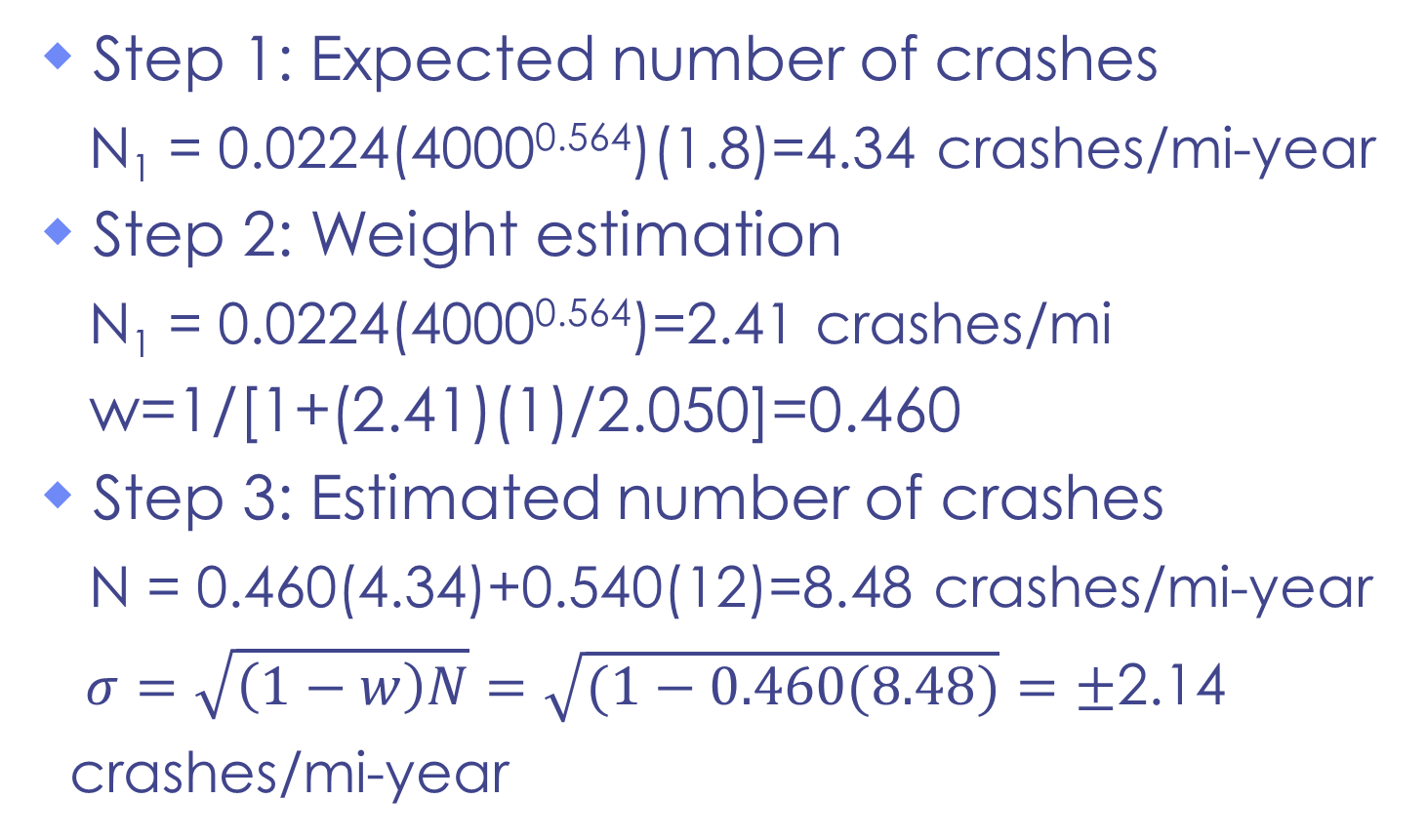
EB Example (2/4)
Step 1: Expected number of crashes
N₁ = 0.0224(4000^{0.564})(1.8)=4.34 crashes/mi-year
Step 2: Weight estimation
N₁ = 0.0224(4000^{0.564})=2.41 crashes/mi
w=1/[1+(2.41)(1)/2.050]=0.460
Step 3: Estimated number of crashes
N = 0.460(4.34)+0.540(12)=8.48 crashes/mi-year
$σ=\sqrt{\left(1−w\right)N}=\sqrt{(1−0.460(8.48)}=±$2.14
crashes/mi-year
Notes:
The steps required for answering the question are noted here. Step 1 estimates the number of expected crashes at the site for the given year based on the SPF from similar sites. Step 2 calculates the weight for the function based on the estimate from other similar sites (converted on a per mile basis) and the overdispersion parameter given. The number of crashes is estimated in Step 3, where the weight is used. The expected number of crashes is between the anticipated from similar sites (4.34) and the actual (12). The standard deviation of the estimated number of crashes is also calculated.

Slide 15
EB Example (3/4)
Assuming availability of three years of data
12, 7 and 8
Same ADT for each year
How many crashes should we expect next year?
Notes:
In this case, a 3-year period is utilized to demonstrate the effect of the larger number of years in the analysis.

Slide 16
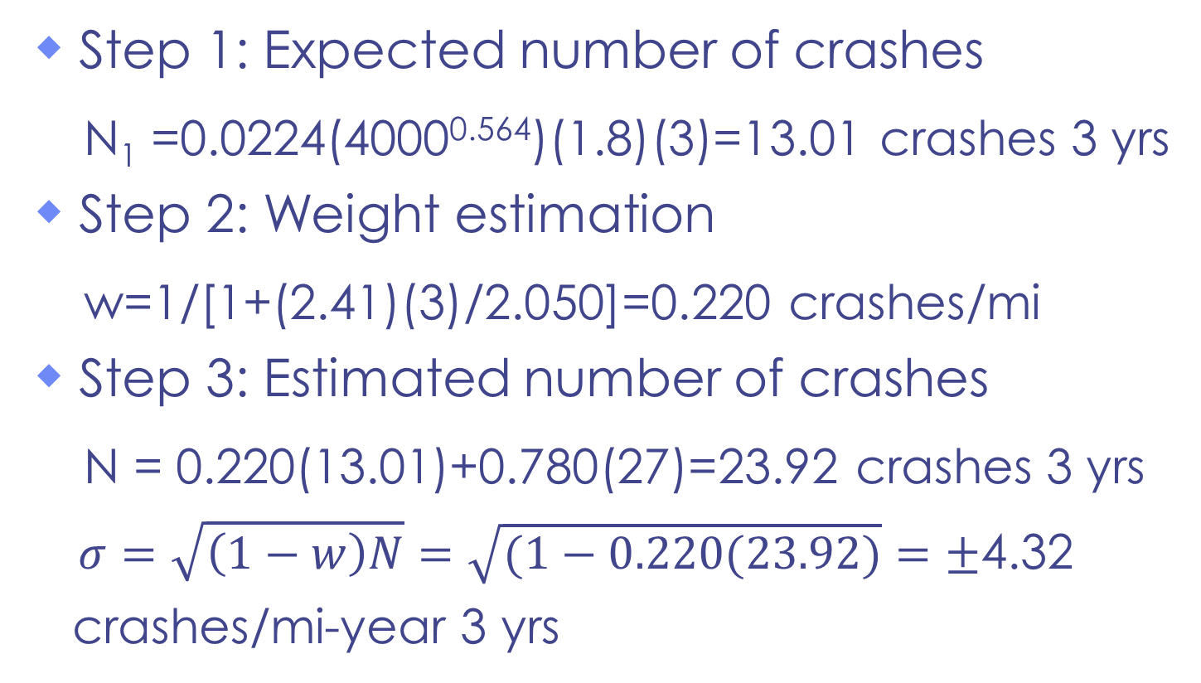
EB Example (4/4)
Step 1: Expected number of crashes
N₁ =0.0224(4000^{0.564})(1.8)(3)=13.01 crashes 3 yrs
Step 2: Weight estimation
w=1/[1+(2.41)(3)/2.050]=0.220 crashes/mi
Step 3: Estimated number of crashes
N = 0.220(13.01)+0.780(27)=23.92 crashes 3 yrs
$σ=\sqrt{\left(1−w\right)N}=\sqrt{(1−0.220(23.92)}=±$4.32
crashes/mi-year 3 yrs
Notes:
The same steps as in the previous example are taken here as well. The only difference is that a 3-year value is used in the calculations for N₁ and φ. It should be also noted that the number of observed crashes is 9, which is the average of the three years of data obtained. In this case, the estimated number of crashes for a 3-year period is 23.92 crashes, which lies between the estimated value (13.01) and the actual (27). This example also demonstrates the impact of multiple years of crashes. The weight associated with model prediction is reduced (0.220 vs. 0.460 in the one-year data) thus placing more emphasis on the estimate from the observed data.

Slide 17
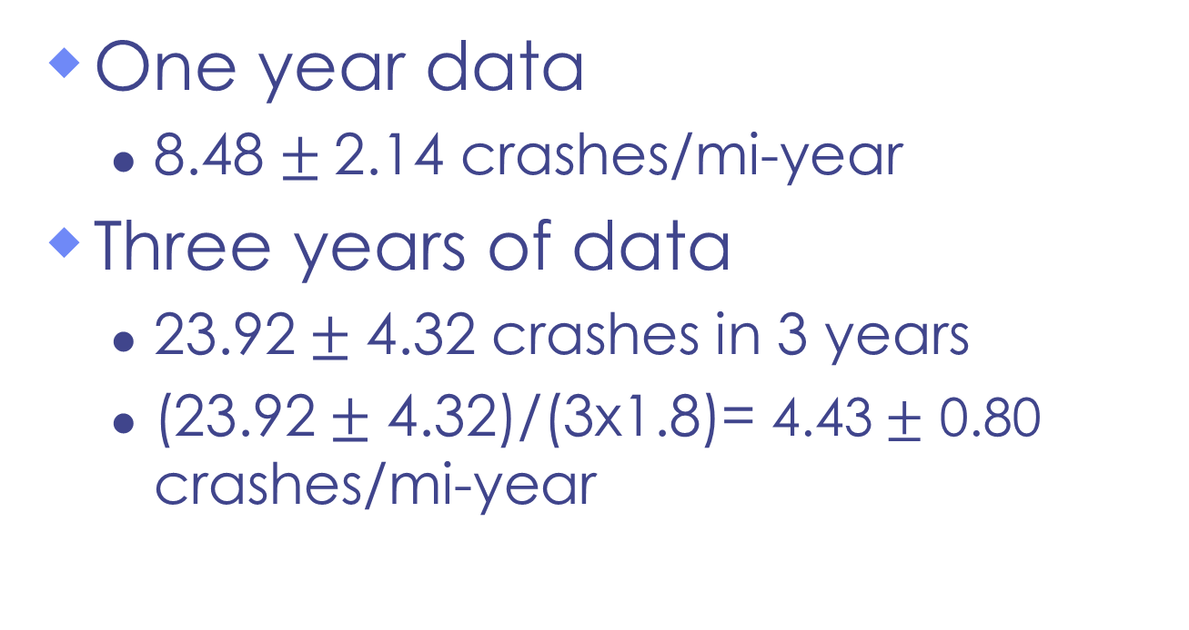
EB Example Summary
One year data
8.48 $±$2.14 crashes/mi-year
Three years of data
23.92$±$ 4.32 crashes in 3 years
(23.92$±$ 4.32)/(3x1.8)= 4.43$±$ 0.80 crashes/mi-year
Notes:
The effect of multiple years of data is noted here where greater emphasis is placed on actual data than the predicted numbers. Also, the standard deviation is getting smaller. The larger number of years also allows for a more accurate prediction and regression to the mean can be eliminated. For the 3-year data, the final estimate is converted into an annual estimate, since the original question is “How many crashes should one anticipate next year in this site?”.

Slide 18
Safety Performance Function
Relationship of crashes to other variables
Basic question
What is the expected number of crashes?
Forms
Linear Y= a+bx
Non-linear Y=e^{a+bx}
Multi-variate Y=a₀+a₁x₁+a₂x₂+…+a_{n}x_{n}
Notes:
The SPFs identify the relationships of crashes to other variables of concern. These typically contain offset variables, including length and volume to account for the importance of the exposure, as well as explanatory variables that identify the potential contribution of various factors on a crash. Such variables typically include roadway geometry elements (e.g., lane and shoulder widths, presence of median and type, curvature, grade, etc.).
The basic effort here is to predict the expected number of crashes at a site given its features. An SPF can assist in this and determine the anticipated number of crashes based on historical data (as seen in the EB example before). The SPF can take a variety of forms, including linear, non-linear or multi-variate. Typically, a number of forms are examined in order to develop the most appropriate model for the available data.

Slide 19
Regression Basic Stats
Form
Y = a+ b X
b slope of line; a intercept
Basic tests
Is b = 0?
How good is the model?
Is a = 0?
Notes:
The linear regression basic form is shown above. In this set up, the slope indicates a corresponding increase between the estimate and the predictor with a positive sign and a decrease when the sign is negative.
The issues of concern with a linear regression focus on whether the parameters a and b are not zero. The basic idea here is that a slope of zero will indicate complete randomness of the data and lack of any model fit. An intercept of zero indicates that the prediction will be equal to zero when all predictors (X in this case) are set to zero. However, this is difficult to achieve and frequently the intercept is different than zero.
The model needs to be examined for goodness of fit and in this case various statistical metrics can be used (as discussed in the following). In addition to the statistical metrics, one needs to consider also the rationality of the model and examine the sign of the slope for reasonableness. A priori knowledge of anticipated variables should be examined in order to determine whether their signs are reasonable.

Slide 20
Regression Output
R² 35% of observed variation
SC=1023.5 +55.848 DR
b & a not 0
Notes:
These are the results of an example regression that examined the number of years of driving experience to the scores of a driving knowledge test.

Slide 21
Approach Steps for Studies (1/2)
Identify area of interest
Collect background information
Form potential research hypotheses
Gather/identify data
Form a single research hypothesis to be tested with available data
Perform a descriptive and investigative analysis of the data
Notes:
These two slides demonstrate the steps required for a study and follow basic engineering concepts and principles.

Slide 22
Approach Steps for Studies (2/2)
Perform the test(s)
Compare results to past results
Develop potential explanations
Discuss limitations of the findings
Discuss applicability of findings
Determine future research

