Slide 1
HIGHWAY SAFETY MANUAL
Copyright © 2016 STC, UK
Notes:
This module reviews fundamental statistics related to safety analysis. It is critical to have a basic understanding of the models to be developed in order to apply the statistical methods and tools correctly for safety analysis. Even though current highway safety analysis techniques have moved beyond basic statistics, an understanding of statistical fundamental concepts can be useful in any analysis.

Slide 2
Learning Outcomes
Introduce the Highway Safety Manual
Define procedures and techniques
Demonstrate use of
Safety Performance Functions
Crash Modification Factors
Notes:
The main objective of the session is to familiarize workshop participants with the Highway Safety Manual procedures and applications. Participants will be able to use the technical information presented and apply the tools of the Highway Safety Manual effectively upon completion of this workshop. Examples and exercises are included to demonstrate concepts.

Slide 3
Safety always comes first
in everything we do!
Notes:
This may be true but most times, there is a need to trade off between various competing project issues and attributes.

Slide 4
Safety & Roadway Design
Each design assumes a safety level
Section 109, Title 23, USC
Need for balancing of safety, mobility, economic considerations, protection and enhancement of natural environment, and preservation of community values
Tradeoffs among design, cost, and safety
Notes:
Examples of such trade offs could be considered the following:
Safety vs Operational efficiency: Often right turn on red is allowed to
improve operational efficiency at the expense of safety
Safety vs Budget: Divided highways are frequently safer than other
roadways but not all roadways are constructed with medians.

Slide 5
Decision Making Process
Environment
Safety
Society
Right of Way
Costs
Capacity
Notes:
Until recently, transportation professionals did not have a single national resource to use in estimating safety performance. The HSM provides professionals with a much needed resource where current knowledge, techniques, and methodologies to estimate future crash frequency and severity are presented. Professional now have a set of predictive methodologies that can use in predicting crashes and quantitatively evaluate alternative designs. The new methods in the HSM are more statistically rigorous and reduce past issues of random variations of crash data.

Slide 6
Basic Safety Questions?
How can I predict safety performance of geometric design features?
How can I quantitatively calculate safety effects?
How can I justify decisions based on safety implications?
Notes:
An agency or a practitioner, typically requires answers to these questions. For example, one may need to know what will be the safety performance for a horizontal curve and what may be the tradeoffs between a larger radius and the its associated costs and its safety gains. Similar questions can be posed for decisions regarding any geometric feature in evaluations of design elements and the selection of the appropriate value in order to balance costs and benefits.
The HSM can answer these questions by:
Providing proven and vetted science-based approach to quantifying safety effects of decisions and actions a professional contemplates
Providing common knowledge base, language and basis for reasoned safety judgments
Allowing incorporation of safety to same level of importance as other factors
Not increasing risk of tort liability

Slide 7
Highway Safety Manual Purpose
Resource for professionals
Safety knowledge
Decision making tools
Notes:
The Highway Safety Manual (HSM) is a resource for professionals that provides safety knowledge and decision making tools in order to allow for a systematic evaluation of safety impacts in highway design. The HSM organizes these tools in a useful form to enable improved decision making based on safety performance. The HSM fills the gap of lacking quantitative information that could aid decisions. Moreover, the HSM is a platform for assembling current information and methodologies on measuring, estimating and evaluating roadways in terms of crash frequency and severity.

Slide 8
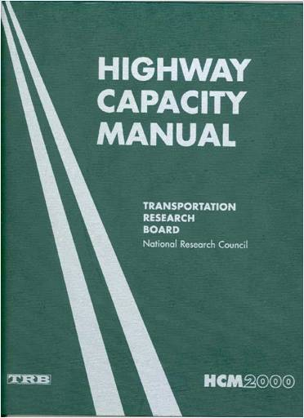
The HSM is…
Analysis tool
Estimations of safety performance
Prediction of crashes
Notes:
The HSM is a toolbox that professionals can use to evaluate or estimate the safety performance of a facility and in this respect is very similar to the Highway Capacity Manual.
The HSM provides users with a process on how to use the tools provided along with direction on which tools are appropriate to use in estimating safety performance.
The HSM provides the user with safety estimates of alternative choices and allows for the development evaluating design options and treatments to improve safety performance.
The HSM provides the required quantitative data for a decision maker to determine the most appropriate solution for a given scenario and support their judgment.

Slide 9
The HSM is NOT…
Best Practice guide
Warrants
Standards
Notes:
The HSM is NOT like other AASHTO publications, such as the MUTCD, that provide user with definitive requirements, i.e., standards and warrants.
The HSM does not require any user obligations to follow a particular design or warrant but rather provides a process for a quantitative decision.
The HSM will NOT tell the user that a particular option should be adopted.

Slide 10
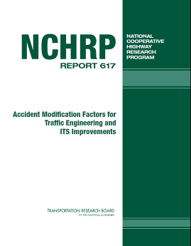


HSM 2010
Notes:
The HSM 2010 is a compilation of past research that was sponsored by AASHTO and FHWA and provides the user with current trends in highway safety. The HSM provides a state-of-the-art information and is the definitive resource for such collection of knowledge. It is also anticipated that the HSM will be updated periodically to reflect future research findings and present future trends in safety analysis and evaluation.

Slide 11
A Safe Roadway?
List what are the top three items that make a roadway safe
1.
2.
3.
Notes:
The idea for this is to identify elements that the students may consider as safe feature for a highway. Answers could include wide lanes, wide shoulders, clear zones, medians, guardrails, proper vertical and horizontal alignment, good pavement condition, available sight distances, provision of stopping sight distances greater than the minimum, and placement of proper barriers around immovable obstacles. You may also indicate that a road with no vehicles could be safe☺
The discussion should lead towards the next few slides, where the point is to identify the relativity of safety features (nominal and substantive safety) and the fact that roadway geometry has the potential to influence driving behavior (curvy roads typically lead to slower driving than straight ones).

Slide 12
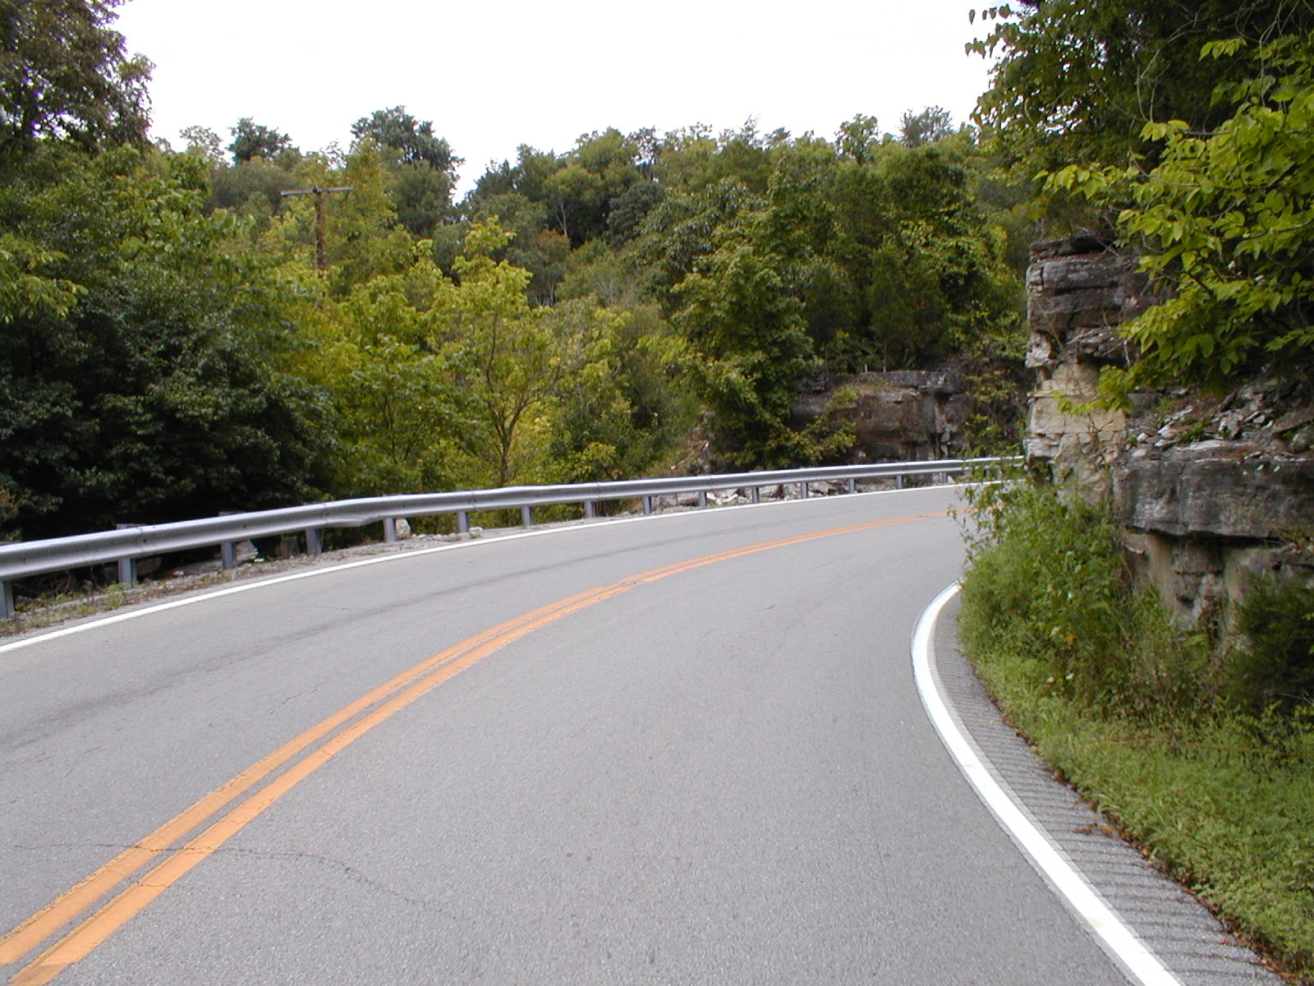
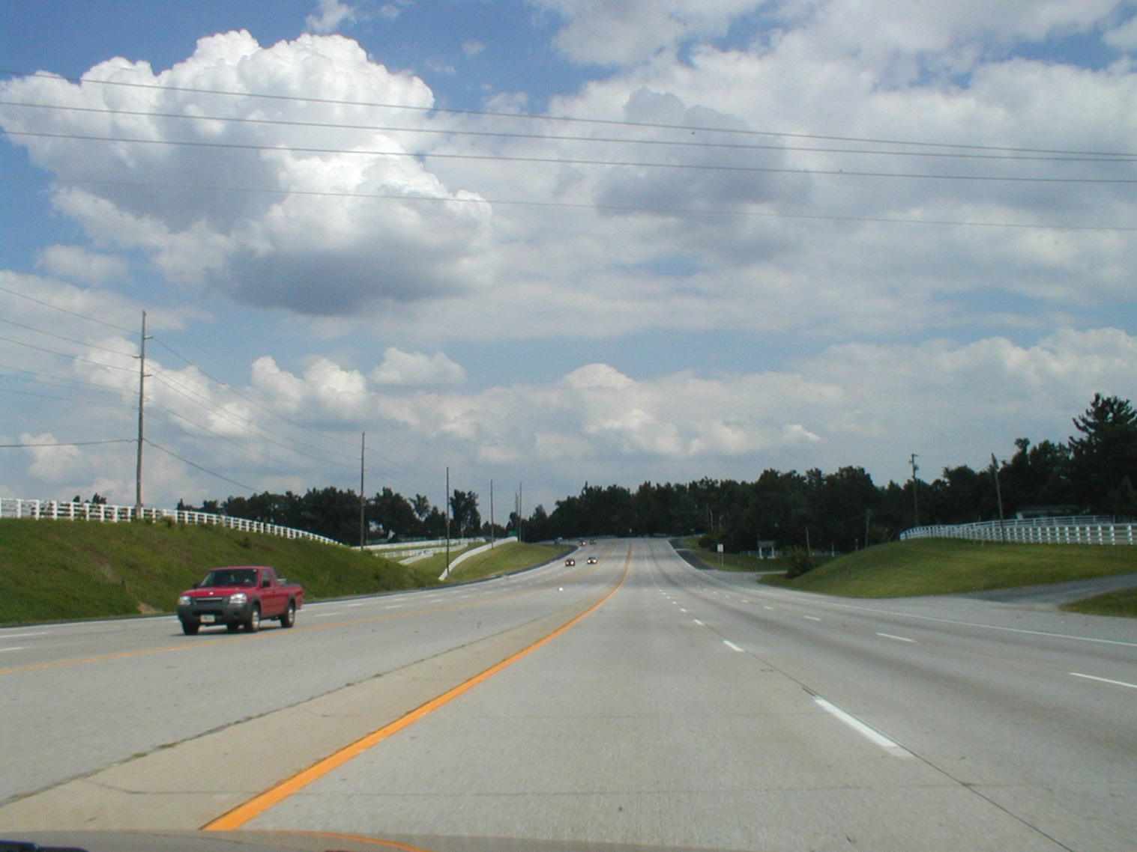
Safe Roadway?
Notes:
Question to be posed here is “Which roadway is safer?” The answer should focus on the concept that we need more information to reach a decision and we need a systematic approach to do this. Also, the idea that roads do not always perform as intended when it comes to safety should be raised. In this case, designs of straight and wide roads may result in more unsafe roads. Drivers may compensate for what is perceived more dangerous and thus safety is not a black and white issue but rather one that requires other factors to be considered as well. For the photographs shown here, the first one had 25 crashes in 2014 with an ADT of 40,000 and a rate of 1.71 crashes per million vehicle-miles of travel (MVMT) and the second had 3 crashes with 6,000 ADT and rate of 1.37 per MVMT. In this case, the crash experience of the first road is “worse” than the second, even though the first one gives the impression of a “safer” roadway.

Slide 13
Safety Levels
Nominal safety
Measured as compliance to standards, warrants and guidelines
Yes/No
Substantive safety
Measured by crash frequency and severity
Continuous scale
Notes:
Nominal safety is a term coined by Dr. Ezra Hauer that describes whether a design adheres to design standards and practices. Under this approach, a road is “nominally safe” if it meets the required standards and guidelines.
On the contrary, substantive safety (or perhaps quantitative safety) is its actual or expected performance in terms of crash frequency and severity. Substantive safety is not only affected by the basic characteristics of the road, but it is also affected by all other resources (e.g. maintenance, law enforcement, etc.) devoted to the road.
Hauer, E. Safety in Geometric Design Standards University of Toronto, Toronto, Canada. 1999.

Slide 14
Nominal vs. Substantive Safety
Crash Risk
Design Value
Notes:
In the nominal safety concept, there is a simplistic approach evaluating whether the facility complies with the prescribed standards or guidelines. In this case, any choice outside the value will be considered unsafe and in this case the road either meets the standard or not.
Professionals frequently are called to make decisions and evaluate incremental effects of a design value. For example, one may want to know what are the safety effects of reducing the lane width by 1 foot or increasing shoulder width by 2 feet. The nominal safety approach does not allow for this estimation. In this case one needs to estimate these changes and approach the project under the substantive safety model.
The HSM provides the tools to estimate such incremental differences and provide professionals with a needed tool to characterize the shape and values of the substantive safety curve for the range of highway types and conditions they would typically encounter.

Slide 15
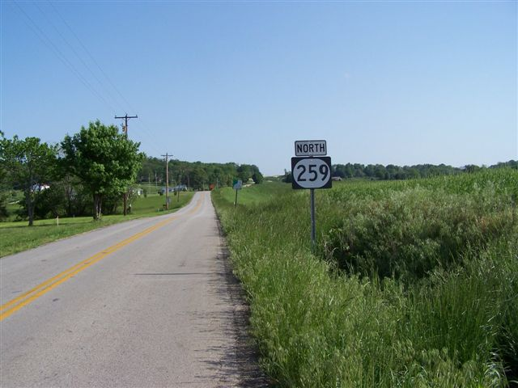
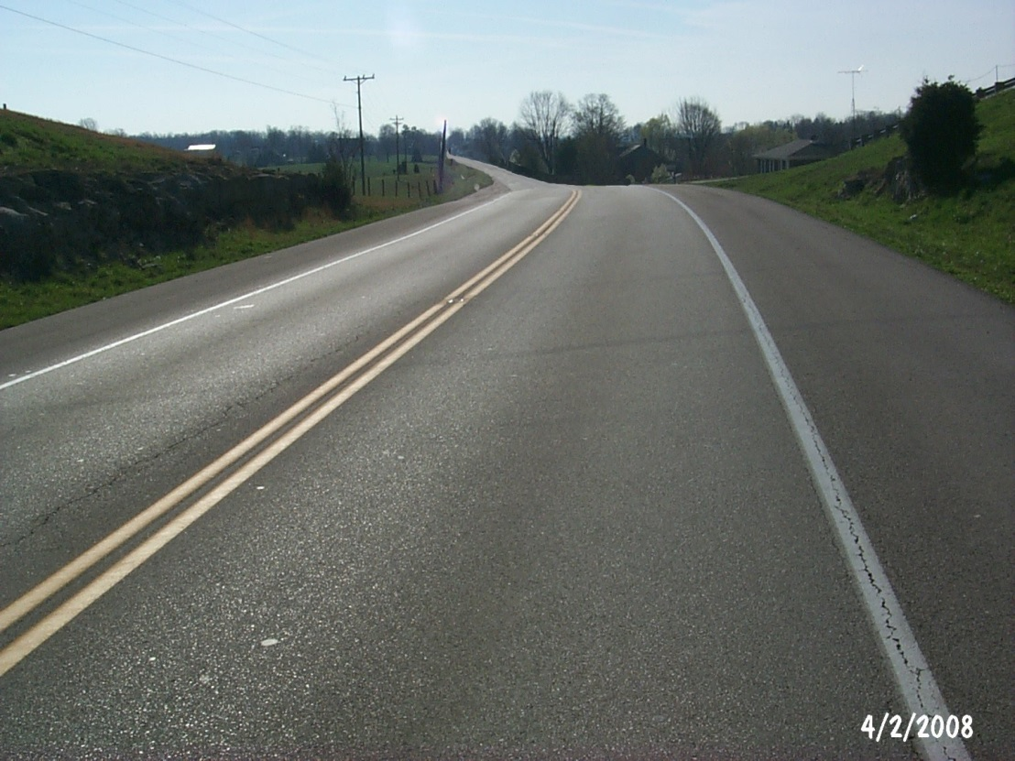
HSM Tools
Notes:
HSM can help professionals decide on whether an alternative design option is feasible and what are the safety effects from such choices. For example, when considering upgrading a 2-lane rural road with no shoulders one can identify what will be the benefits of increasing only shoulder width or increasing only lane width or converting to a super 2. These benefits then can be quantified based on crash values and compared to costs of construction to determine a benefit/cost ratio.

Slide 16
Crash Prediction Uses
Program level
Segment prioritization
Project level
Project needs assessment
Communication with the public
Documentation
Tort Defense
Notes:
Transportation agencies can use crash prediction in various levels. At the program (planning) level, these predictions can be used to identify hazardous locations/segments and prioritize them in order to address the most pressing needs.
At the project level, crash predictions can assist in establishing and assessing the needs of the project (can be utilized in the purpose and need statement), to demonstrate the impacts of alternative designs during public meetings and communicate these choices to the public, and to document decisions reached during the design of the project justifying choices.
The latter can be very useful in tort defense, since all decisions could be documented and readily available.

Slide 17
HSM Contents
HSM
Part A
Part B
Part C
Part D
Introduction, Human Factors, Fundamentals
Safety Management Process
Predictive Methods
Crash Modification Factors
Notes:
The HSM is divided into four parts. In part A the user is provided with an introduction to the HSM, knowledge about human factors and the fundamentals of highway safety. Part B covers the roadway safety management process. In Part C predictive methods are introduced for different facility types. And, last but not least, Part D provides Crash Modification Factors (CMFs) for use with Part B. It is important to keep in mind that Part D can only be used with Part B – Part C has its own AMFs for each facility type. This issue is further addressed later in the presentations.
The first edition does not cover driver education, enforcement, and vehicle safety, even though it is recognized that these are important elements which can help reduce injuries and fatalities from motor vehicle crashes.

Slide 18
HSM Companion Software
HSM Part | Supporting Tool
Part B: Roadway Safety Management Process | SafetyAnalyst www.safetyanalyst.org
Part C: Predictive Methods | IHSDM www.ihsdm.org
Part D: Crash Modification Factors | FHWA CRF/CMF Clearinghouse www.cmfclearinghouse.org
Notes:
Current software (as of August 2015) is noted here. The Safety Analyst can assist with the safety management process at the state level. IHSDM can assist in estimating safety impacts from design choices and assess compliance with existing policies. Finally, the Clearinghouse provides up to date information on CMs and CRFs and ranks them based on their robustness.

Slide 19
Some More Questions
What is the number of crashes for a given scenario?
2-lane rural road with 5,000 AADT
4-lane rural arterial divided arterial with 20,000 AADT
What will be the safety effect if we
Widen shoulder
Add a median
Add a left-turn lane
Notes:
The goal in this process is to be able to quantify the anticipated crashes for any given scenario. This is the critical question that any person involved in any stage of the project development process is trying to address. The answer will provide quantifiable results and allow to decisions to be made through a well-documented process.

Slide 20
How HSM Works
Predicted
Crashes
SPF
CMF
C
Safety Performance Function(SPF): regression equation
Crash Modification Factor (CMF): adjustment factors
Calibration Factor (C): local adjustment
Notes:
The predicted crashes are the “expected average number of crashes”. The use of the SPF indicates the application of a statistical method and the answer is not an exact number, as is frequently the case in engineering, but rather a statistical
estimate. This means that if we record crashes in several sites with similar characteristics, then, on average, we can expect to measure that particular number.

Slide 21
Part C: Predictive Methods (1/3)
SPF
Safety Performance Functions (SPFs)
Regression models
Predict expected crash frequency
Developed from data for a number of similar sites
Developed for specific site types and “base conditions”
Notes:
SPFs are regression models that are developed using historical data from a set of sites with similar characteristics. Sites can be aggregated based on lane width, shoulder width and type, degree of curvature, presence of median or any other geometric features that could provide for such classification.
The model developed could predict the expected number of crashes for these sites and can be used to estimate crash performance for sites with similar features. The models establish the base conditions based on the common features of the sites used in the prediction. The models are typically a function of ADT.
It is desirable to use a 3-5 year historical data, if available, when developing these models per HSM recommendation. It should be also noted that “base” conditions could vary from state to state and this should be evaluated if one wants to use the HSM models.

Slide 22
SPF Development
SPF
Crashes/Year
Average Daily Traffic (ADT)
Notes:
Here is an example of how an SPF can be developed.
Assuming that the four data sets depict the crash experience over 5 years for a set of sites with similar features. It can be assumed that the all sites are 2-lane roads with 12-foot lanes, 8-foot shoulders, and no curves.
A curve is fitted through these 4 entities using a negative binomial regression formula. The line is the “best fit” of all the data and is the Safety Performance Function (SPF). The line represents the change in the mean expected number of crashes at all similar entities as ADT (or other exposure measure) increases, while all other factors affecting crash occurrence are held constant. It should be noted that this is an example and typically SPFs are based on a far greater number of sites for greater accuracy.
Sites that lie above the SPF indicate a mean expected crash frequency in excess of the average for comparable sites. One can think about sites with mean risk above the SPF as those with higher than average risk and those below the line as those with lower than average risk. SPFs have been compiled into safety analysis tools, such as Safety Analyst and the Highway Safety Manual (HSM). However, since crash patterns may vary in different geographical areas, SPFs must be calibrated to reflect local conditions (e.g., driver population, climate, crash reporting thresholds, etc.).

Slide 23
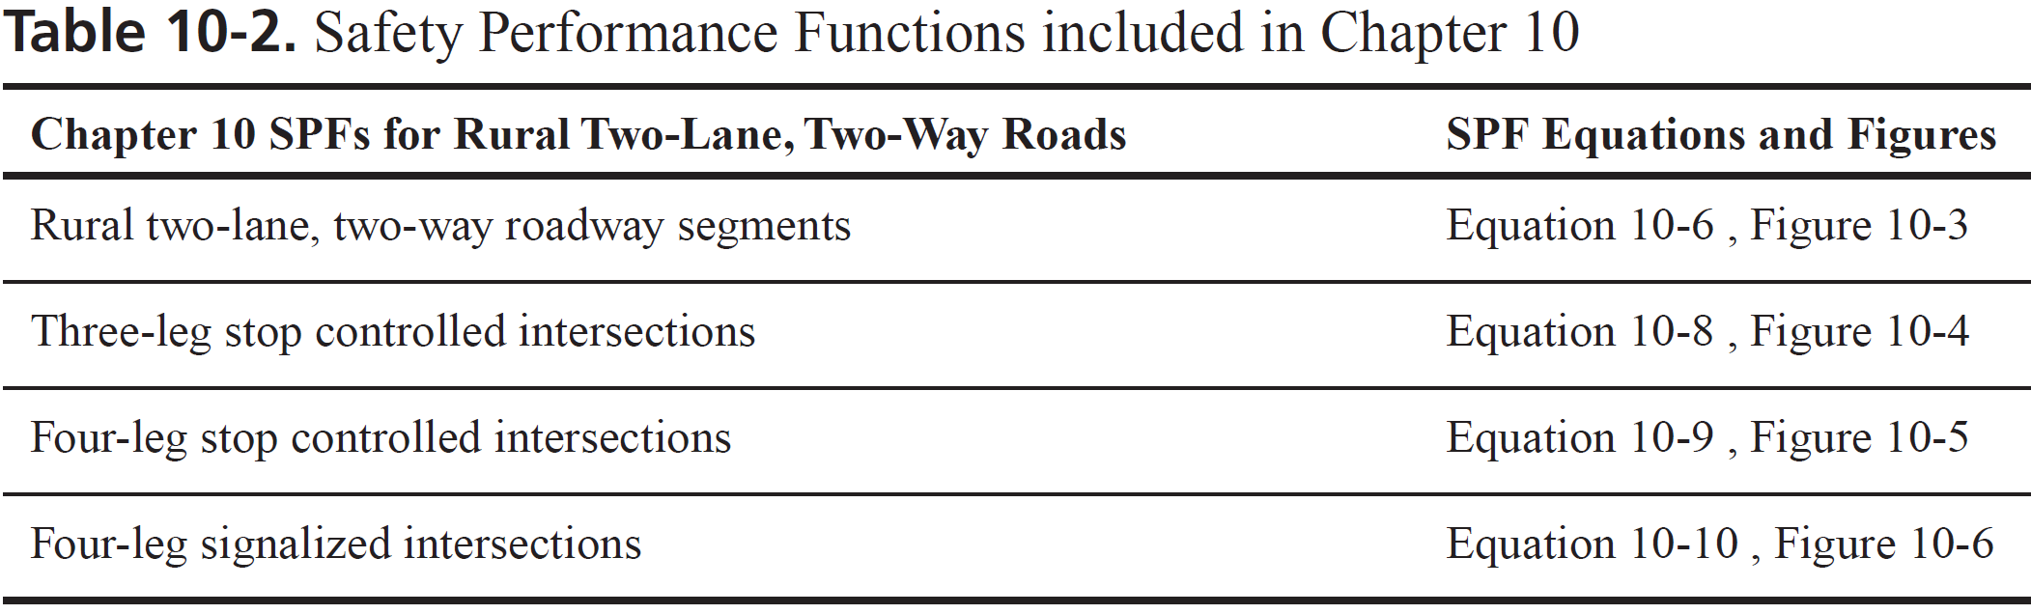
SPF Example: 2-Lane Rural Roads
N_{spf rs} = AADT x L x 365 X 10⁻⁶ x e^{(-0.312)} (Eq. 10-6)
Note: assumed crash type and severity distribution
Notes:
10.6. SAFETY PERFORMANCE FUNCTIONS
The appropriate safety performance functions (SPFs) are used to predict average crash frequency for the selected year for specific base conditions. SPFs are regression models for estimating the predicted average crash frequency of individual roadway segments or intersections. Each SPF in the predictive method was developed with observed crash data for a set of similar sites. The SPFs, like all regression models, estimate the value of a dependent variable as a function of a set of independent variables. In the SPFs developed for the HSM, the dependent variable estimated is the predicted average crash frequency for a roadway segment or intersection under base conditions and the independent variables are the AADTs of the roadway segment or intersection legs (and, for roadway segments, the length of the roadway segment).
The SPFs used in Chapter 10 were originally formulated by Vogt and Bared (13, 14, 15). A few aspects of the Harwood et al. (5) and Vogt and Bared (13, 14, 15) work have been updated to match recent changes to the crash prediction module of the FHWA Interactive Highway Safety Design Model (3) software. The SPF coefficients, default crash severity and collision type distributions, and default nighttime crash proportions have been adjusted to a consistent basis by Srinivasan et al. (12).
The predicted crash frequencies for base conditions are calculated from the predictive models in Equations 10-2 and 10-3. A detailed discussion of SPFs and their use in the HSM is presented in Chapter 3, Section 3.5.2, and the Part C—Introduction and Applications Guidance, Section C.6.3.
Each SPF also has an associated overdispersion parameter, k. The overdispersion parameter provides an indication of the statistical reliability of the SPF. The closer the overdispersion parameter is to zero, the more statistically reliable the SPF. This parameter is used in the EB Method discussed in Part C, Appendix A. The SPFs in Chapter 10 are summarized in Table 10-2.
HSM, Vol 2, page 10-14

Slide 24
Part C: Predictive Methods (2/3)
CMF
Crash Modification Factors (CMFs)
Adjusts SPF predicted value
Accounts for differences between base and site specific conditions
Notes:
Crash Modification Factors allow for estimating the impact of a change in the value of a design element. This allows designers to estimate the relative change in the predicted number of crashes for deviating from the selected design value and determine the potential implications from a design choice. These factors are similar in nature to those used in the Highway Capacity Manual for adjusting from the base conditions for lane and shoulder width, presence of median, access frequency, etc.

Slide 25
Part C: Predictive Methods (3/3)
C
Local calibration factor (C_{r})
Adjusts SPF from HSM to local conditions
Addresses local variations
Notes:
Typically, local conditions will vary from those where the SPFs n the HSM have been developed. Calibration factors are developed to adjust the SPFs to the local conditions.
The SPFs included in the HSM (Part C) have been developed base do on data from select states in the USA. However, there are several areas where differences that could be noted between the local conditions and those of the model development areas including climate, driver populations, crash reporting thresholds, and crash type and severity distributions. In these cases, a calibration factor is recommended to be developed to address these differences when the HSM SPFs are used.

Slide 26
HSM Prediction Models
Prediction models for
Homogeneous highway segments
Intersections
Segments based on homogeneous
Geometry
AADT ranges
Notes:
The Analysis divides the highway into homogeneous analysis sections based on whether they are intersections or roadway segments. Each analysis section is homogenous with respect to geometry and traffic conditions.
Homogeneous highway segments have uniform horizontal, vertical, cross section, traffic characteristics, and roadside geometry. At any location where there is a change in geometry (e.g., changing from a horizontal curve to a tangent or a change in shoulder width) or a change in traffic volume, a new highway segment begins.
Each intersection is also defined as a separate, homogenous analysis section.

Slide 27
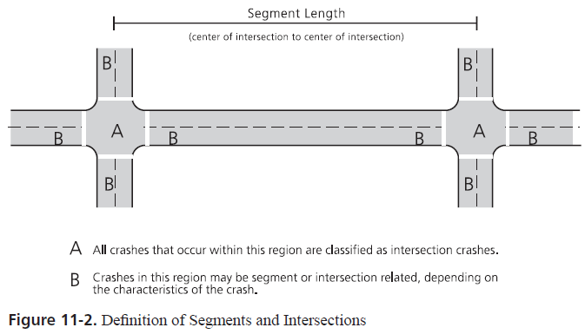
Segments and Intersections
Notes:
10.5. ROADWAY SEGMENTS AND INTERSECTIONS
Roadway segments begin at the center of an intersection and end at either the center of the next intersection or where there is a change from one homogeneous roadway segment to another homogenous segment. The roadway segment model estimates the frequency of roadway-segment-related crashes which occur in Region B in the figure above. When a roadway segment begins or ends at an intersection, the length of the roadway segment is measured from the center of the intersection.
Chapters 10, 11 and 12 (multilane) provide predictive models for stop-controlled (three- and four-leg) and signalized (four-leg) intersections. The intersection models estimate the predicted average frequency of crashes that occur within the curb line limits of an intersection (Region A of figure above) and intersection-related crashes that occur on the intersection legs (Region B in figure above).
HSM, I Vol 2 page 10-11

Slide 28
HSM Process
Define Data
Limits, Type, Time, Geometry, AADT
Segment Facility
Geometry, AADT
Predict Crashes
SPF
Adjust Crashes
CMF, C
Notes:
HSM Process
The predictive method for each facility can be summarized as shown above. The first steps involve the collection of required input data including:
Limits of the roadway and facility type in the study;
Period of interest;
Geometric design features, traffic control, and site characteristics;
Availability of traffic volume for the study period;
For intersections, AADT volumes are needed for both the major and minor streets; and
If the EB Method is used, AADT traffic volumes are needed for each year for which observed crash data are available.
The next step requires the segmentation of the facility into individual homogenous (or similar) roadway segments or intersections. For roadway segments, the recommended site length is equal to or greater than 0.10 miles. Smaller segments would result in excessive and needless calculations. Boundaries can be defined based on cross section, AADT, and alignment changes as well as with the presence of intersections. The HSM includes recommendations for rounding variables that then helps clarify the boundaries of homogeneous segments. This information is located on pages 10‐12 to 10‐13 (for rural two‐lane segments), pages 11‐12 to 11‐13 (for rural multilane highway segments), and page 12‐15.
The next steps involve the estimation of the predicted crashes through the SPF (by using the appropriate function for the roadway type evaluated) and the adjustment to the local conditions though the use of CMFs and the calibration factor.

Slide 29

Cross Sectional Elements
Notes:
The entire cross section is of interest when one considers safety. This includes lanes and shoulders, as well as the roadside. The effects fo each component need to be considered when evaluating safety.

Slide 30
Safety and Operational Effects
Crashes Operations
Head-on Capacity
Wider is “better” Wider means “faster”
Run-off-Road Capacity
Wider is “better” Functionality
Run-off-road (severity) Maintenance
Flatter is better Flatter is better
Run-off-road Horizontal sight
(frequency and severity) distance
Lane Width
Shoulder Width
Sideslope
Clear Zone
Notes:
There are safety and operational effects for each cross sectional element. Some are positive and some are negative and there are interactions. For example wider lanes may improve safety but they encourage greater speeds, which could be impacting safety negatively.

