Slide 1
HIGHWAY SAFETY MANUAL APPLICATIONS
Copyright © 2016 STC, UK
Notes:
This module presents a basic overview of the processes used in the HSM and provide participants with an example application.

Slide 2
HSM Crash Prediction Method
Seg.
Total Predicted
Crashes
Int.
Total predicted crashes: expected number of crashes
Int.: Expected crash frequency for all intersections
Seg.: Expected crash frequency for all roadway segments
Notes:
In general, the total number of predicted crashes for a facility will be equal to the sum of predicted crashes for roadway segments and intersections.

Slide 3
Prediction Model
N_{predicted} _{i} = N_{spf} _{i} x (CMF₁ … CMF_{x}) C_{i}
N_{predicted} _{i} = Expected crash frequency for an individual element
N_{spf} _{i} = Expected crash frequency for base conditions for an individual element
CMF_{i} = Crash Modification Factors for individual design elements
C_{i} = Calibration factor
Notes:
The equation for predicting the expected total crash frequency, N_{predicted i} on a particular homogenous highway segment, where i is a roadway segment or an intersection.
This model can be used to estimate total predicted average crash frequency or average crash frequency of specific crash severity types or specific collision types depending on the SPFs and CMFs utilized.

Slide 4
Segment SPFs
2-lane Rural
N_{spf} _{rs} = (AADT_{n})(L)(365) (10⁻⁶) e^{-0.312}
Multilane, Rural Undivided
N_{spf ru} = e^{(a + b} ^{Ln} ^{AADT + Ln L)}
Multilane, Rural Divided
N_{spf rd} = e^{(a + b} ^{Ln AADT + Ln L)}
Notes:
The equations shown here are for rural road segments and represent the base conditions. The equations are used to predict the expected crashes per year on individual highway segments based upon traffic volume and segment length. Each assumes the appropriate base conditions for geometric and traffic control elements, which are discussed next.
For 2-lane roads, the only inputs to the base model are traffic volume and segment length. For the multilane roads, the parameters a and b are defined based on the type of crash severity predicted, i.e., they are different for total and fatal and injury predictions. These values are defined in Tables 11-3 and 11-5 for undivided and divided segments, respectively.
Each equation has a usable range of AADT that is based on the data utilized to develop the models. For example, the SPFs for roadway segments on 2-lane rural roads are applicable to the AADT range from zero to 17,800 vehicles per day. Application to sites with AADTs substantially outside this range may not provide reliable results.

Slide 5
Base Conditions: 2-Lane Rural
Lane Width: 12 feet
Shoulder Width: 6 feet
Shoulder Type: Paved
Roadside Hazard Rating: 3
Driveway Density: <5 driveways/mi
Grade: <3%(abs)
Horizontal Curvature: None
Vertical Curvature: None
Centerline rumble strips: None
TWLTL, climbing, or passing lanes: None
Lighting: None
Automated Enforcement: None
Notes:
These are considered the nominal geometry or base conditions represented by the base model.
It should be emphasized that the values shown here do NOT represent the “safest” values. The reason for selecting these dimensions as the base conditions is statistical. These values are the approximate the mean values for these variables in the database used to fit the base model. This implies for example, that the average lane width for the database used to develop the model is approximately 12 feet. Moreover, the regression models developed have the least standard error near the mean values of these independent variables in the model.

Slide 6
Base Conditions: Multilane Roads
All
Lane width 12 feet
Shoulder type Paved
No lighting or automated speed enforcement
Undivided
Shoulder width 6 feet
Sideslopes 1V:7H or flatter
Divided
Shoulder width 8 feet
Median 30 feet
Notes:
The same notes apply for these values regarding the reason for the selection of the values. An additional note is that the shoulder width used for both divided and undivided is that of the RIGHT shoulder.

Slide 7
SPF Application Example
2-Lane road with AADT = 3,500 vpd and 2 miles long
N_{spf} _{rs} = (AADT_{n})(L)(365)(10⁻⁶) e^{-0.312} =
= 1.87 crashes per year
3500
2
Notes:
Example calculation using the SPF base model for 2-lane rural highway segments. Note that the estimate is the number of crashes per year. It is assumed that the segment geometry complies with the base conditions.

Slide 8
Deviating from Base Conditions
Use of CMFs
N_{predicted i} = N_{spf} _{i} x (CMF₁ … CMF_{x})
NOTE: for 2-lane rural roads a calibration factor (C_{r}) is also used
Notes:
Most times the base conditions will not reflect the actual roadway geometry. In this case, the next step involves the use of the appropriate Crash Modification Factors to the predicted crash frequency in order to account for those conditions that are different that the assumed base conditions.
This model estimates the predicted average crash frequency of non-intersection related crashes (i.e., crashes that would occur regardless of the presence of an intersection).
CMFs are used to adjust the SPF estimate of predicted average crash frequency for the effect of individual geometric design and traffic control features. The CMF for the SPF base condition of each geometric design or traffic control feature has a value of 1.00. Any feature associated with higher crash frequency than the base condition has a CMF with a value greater than 1.00. Likewise, any feature associated with lower crash frequency than the base condition has a CMF with a value less than 1.00.

Slide 9
CMF Notes
Values from tables
Similar to HCM
Some require adjustment
Computed for specific crash types
Need to ensure crash distribution
The effect of application of multiple CMFs is multiplicative, not additive
Notes:
For most CMFs, the values are simply taken from the corresponding tables. Attention should be paid to those that vary by AADT, since different values are used in this case.
The CMFs presented in the tables are for the specific crash types associated for the element adjusted. For example, when computing the CMF for lane width, the associated crashes are single-vehicle run-off the-road and multiple-vehicle head-on, opposite-direction sideswipe, and same-direction sideswipe crashes. This default crash type distribution, and therefore the value of the percent of associated crashes, may be updated from local data as part of the calibration process.

Slide 10
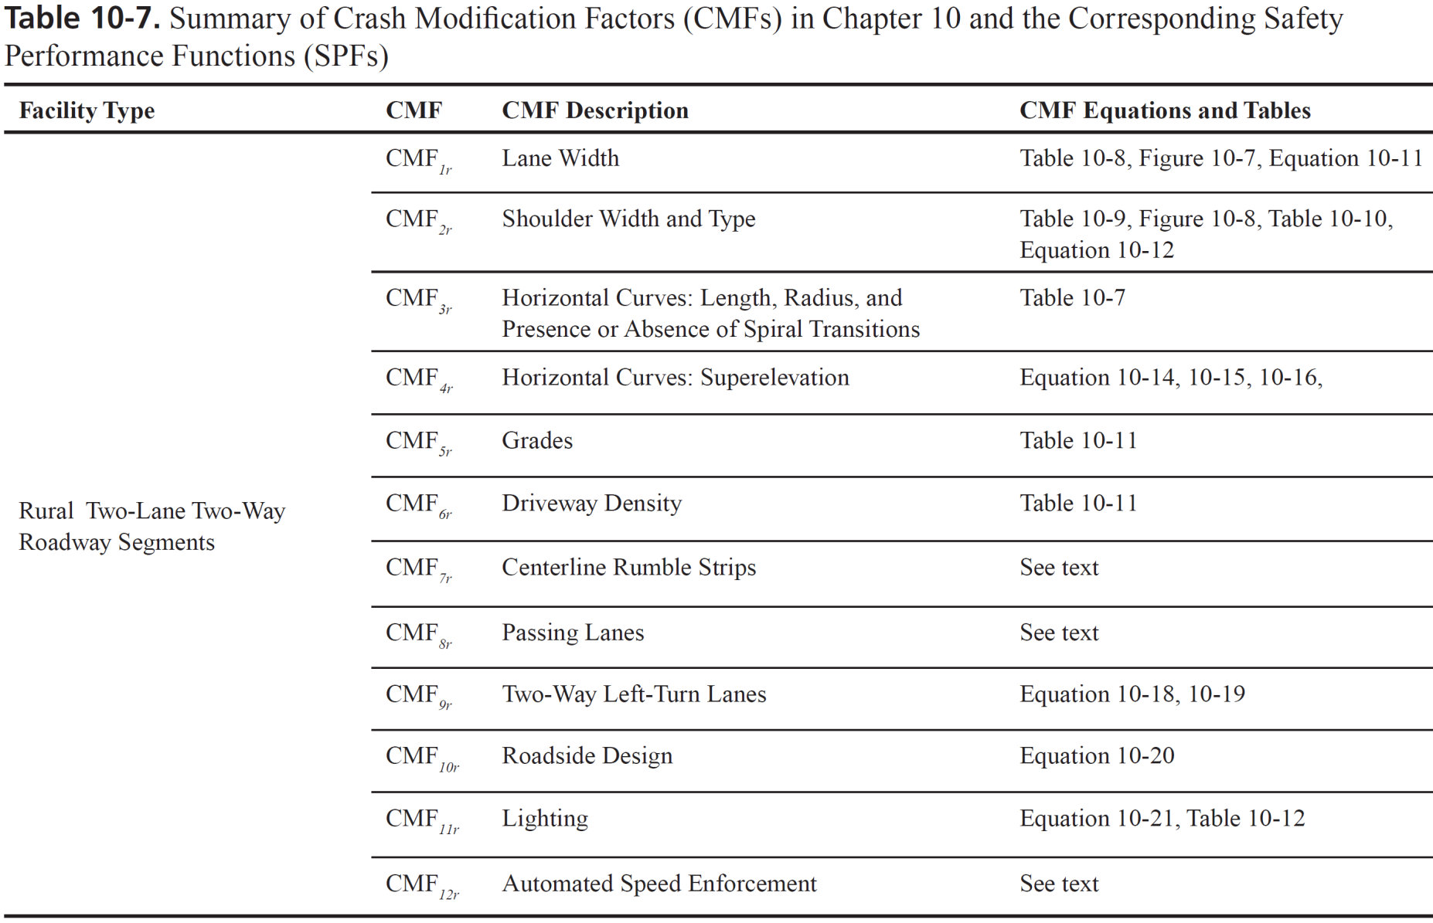
2-Lane Rural Segment CMFs
Notes:
Here is an example of how CMFs are determined to estimate the effect of deviating from the base conditions. Similar tables are available for all road types and both segments and intersections.

Slide 11
CMF Example Calculation (1/5)
CMF_{1r} = (CMF_{ra} – 1.0)p_{ra}+1.0 Eq. 10-11
Notes:
In this example, the CMF for 2-lane rural roads is presented. It should be noted that the CMFs shown in Table 10-8 apply only to the crash types that are most likely to be affected by lane width: single-vehicle run-off-the-road and multiple-vehicle head-on, opposite-direction sideswipe, and same-direction sideswipe crashes. These are the only crash types assumed to be affected by variation in lane width, and other crash types are assumed to remain unchanged due to the lane width variation.
CMF_{ra} = crash modification factor for the effect of lane width on related crashes (i.e., single-vehicle run-off-the road and multiple-vehicle head-on, opposite-direction sideswipe, and same-direction sideswipe crashes), such as the crash modification factor for lane width shown in Table 10-8; and
p_{ra} = proportion of total crashes constituted by related crashes.
The proportion of related crashes, p_{ra}, (i.e., single-vehicle run-off-the-road, and multiple-vehicle head-on, opposite direction sideswipe, and same-direction sideswipes crashes) is estimated as 0.574 (i.e., 57.4 percent) based on the default distribution of crash types presented in Table 10-4. This default crash type distribution, and therefore the value of p_{ra}, may be updated from local data as part of the calibration process.

Slide 12
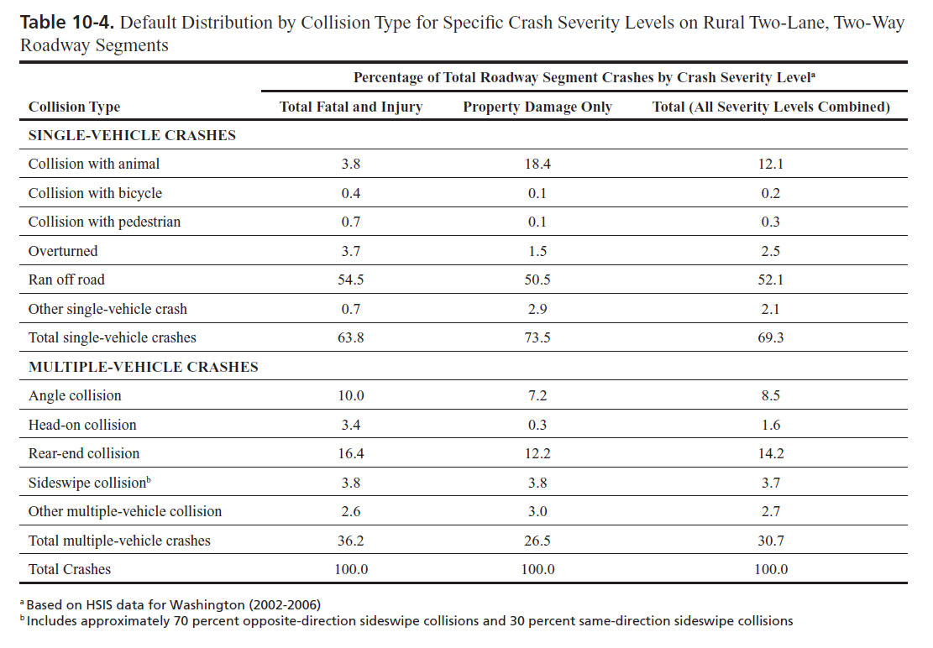
Crash Distribution
Notes:
In the absence of local data, this table can be used to determined the percent of crashes to be considered for lane width calculations. As noted in the previous slide, the only crash types affected are single vehicle ran off the road (ROR), head-on collisions and sideswipe collisions.

Slide 13
CMF Example Calculation (2/5)
AADT 3,500 vpd; Lane width 11 feet
CMF_{1r} = (CMF_{ra} - 1.0) p_{ra} + 1.0 =
1.03
1.05
0.574
57.4
Notes:
Example calculation on determining an CMF_{1r} for Lane Width for total crashes when the CMF_{ra} is given for a particular crash type or severity level.
Here CMF_{ra} is for crash types relating to ROR, Head-On and Sideswipe Crashes.

Slide 14
CMF Example Calculation (3/5)
CMF_{2r} = (CMF_{wra} CMF_{tra}–1.0)p_{ra}+1.0
Notes:
The CMF for 2-lane rural road shoulder is presented here. This CMF accounts for the shoulder width (CMF_{wra}) and the shoulder type (CMF_{tra}). The base value of shoulder width and type is a 6-foot paved shoulder, which is assigned a CMF value of 1.00.
It should be noted that the values in Table 10-8 are only for shoulder related crashes: single-vehicle run-off the-road and multiple-vehicle head-on, opposite-direction sideswipe, and same-direction sideswipe crashes.

Slide 15
CMF Example Calculation (4/5)
Notes:
This table shows the effect of the shoulder type and estimates the CMF_{tra} which adjusts for the safety effects of gravel, turf, and composite shoulders as a function of shoulder width.
If the shoulder types and/or widths for the two directions of a roadway segment differ, the CMF are determined separately for the shoulder type and width in each direction of travel and the resulting CMFs are then be averaged.

Slide 16
CMF Example Calculation (5/5)
AADT 3,500 vpd; 4 foot turf shoulder
CMF_{2r} = (CMF_{wra}CMF_{tra}–1.0)p_{ra}+1.0 =
1.12
1.15
1.05
0.574
Notes:
Example calculation on determining an CMF_{2r} for Shoulder Width and Type for total crashes when the CMF_{wra} and CMF_{tra} are given for a particular crash type or severity level.
Here CMF_{wra} and CMF_{tra} are for crash types relating to ROR, Head-On and Sideswipe Crashes.

Slide 17
Application of CMFs
N_{predicted i} = N_{spf} _{i} x (CMF₁ … CMF_{x})
AADT 3,500, Length 2 miles, 11-foot lanes, and 4-foot turf shoulder
N_{predicted rs} = (1.87)(1.03)(1.12) =
= 2.15 crashes per year
Notes:
As previously noted, the CMFs are used to adjust the base model SPF to the local conditions. In this case, they are used as multiplies to adjust the predicted number of crashes to existing conditions.

Slide 18
Crash Modification Factors
All crashes or some types/ severity
Part C
From SPF development
Part D
Independent research
Countermeasures
Number of CMFs at once
Notes:
It should be noted that CMFs may be applicable to all crash types or certain types and/or severity. Caution should be exercised when using them.
Another notable difference is the use of CMFs in Part C and Part D. Part C CMFs were developed in conjunction with the model development whereas Part D CMFs are based on actual countermeasures. The CMFs from Part D can be used to adjust the SPFs used from Part C.
The user needs to be aware of the fact that using several CMFs simultaneously is not recommended due to the potential interactions among CMFs.
18

Slide 19
HSM Uses
Notes:
This section presents examples of HSM uses and how the processes could be used in estimating cost-benefit impacts from design options and evaluating alternatives.

Slide 20
HSM Potential Uses
Program level
Crash predictions for segment prioritization
Project level
Design element safety prediction
Cost-Benefit justification
Documentation
Notes:
Transportation agencies can use the HSM methods and tools in various levels. At the program (planning) level, these predictions can be used to identify hazardous locations/segments and prioritize them in order to address the most pressing needs.
At the project level, HSM can assist in estimating the relative safety changes among different values for design elements as well as design elements, justifying choices based on cost-benefit analysis of the alternatives evaluated, and to document decisions reached during the design of the project justifying choices. The latter can be very useful in tort defense, since all decisions could be documented and readily available.

Slide 21
Project Level
Design element safety prediction
Use of adjusted SPFs
Use of CMFs
Cost-benefit justification
Estimate crash costs
Compare with construction costs
Notes:
Designers can use the HSM procedures at the project level in two ways. The fists involves the use of SPFs where the number of crashes for each alternative design can be estimated and compared. The second approach relies on the use of CMFs where comparisons for specific elements can be made to justify choices. In this case, the relative change from one value to another can be obtained comparing the corresponding CMFs.
The cost-benefit justification of the choices is essential to finalize the selection of the alternative. The costs are base don the expected number of crashes and they can be estimated on an annual basis. Obviously the difference between crash costs of alternative designs could be considered as the benefits and these need to be compared against the relative construction costs for each alternative. An issue that needs to be pointed out here is that these costs and benefits need to be considered for the entire life cycle of the project.

Slide 22
Example (1/5)
AADT 3,500, 2 mile length, 11-foot lanes and 4-foot turf shoulder
Improvement options
12-foot lanes
Pave shoulder
Notes:
This example presents the use of the HSM methods to evaluate project level decisions. There are two alternative improvement options for the roadway in concern and the decision maker needs to define the one that is more appropriate.

Slide 23
Example – Option 1 (2/5)
New CMF_{1r} = (CMF_{ra} – 1.0)p_{ra} + 1.0 =
Original CMF_{1r}=1.03
Anticipated crash reduction: 3%
1.00
0.574
1.00
Notes:
The first step in evaluating each option is to determine the appropriate CMF assuming that only the specific option will be applied. In this case, the new CMF is calculated for the lane width adjustment and the difference between the two CMFs is used to determine the potential safety effect from the option.

Slide 24
Example – Option 2 (3/5)
CMF_{2r} = (CMF_{wra} CMF_{tra}– 1.0)p_{ra} + 1.0 =
Original CMF_{2r}=1.12
Anticipated crash reduction: 4%
1.15
1.00
0.574
1.08

Slide 25
Example (4/5)
Anticipated crash reductions
Option 1 3%
Option 2 4%
Crash predictions
N_{o}= (1.87)(1.03)(1.12) = 2.15
N₁= (1.87)(1.00)(1.12) = 2.09
N₂= (1.87)(1.03)(1.08) = 2.09
Which one to use?
Notes:
The decision maker has the required data to select the option to implement. In this case, both alternative options will result in similar safety gains and therefore, one may need to consider the associated costs for each option to determine the most beneficial application. The predicted number of crashes is per mile per year and they are the total number of crashes anticipated in the segment.

Slide 26
Example (5/5)
Estimated costs
Option 1 $100,000/mile 10 years
Option 2 $250,000/mile 20 years
Cost per crash reduced
C₁= 100000/[(2.15-2.09)(10)] = $166,478
C₂= 250000/[(2.15-2.09)(20)] = $196,857
Notes:
The costs for each option were obtained from the KYTC databases. The cost per option is estimated and this can assist the decision maker to select the option to implement based on both crash reductions and costs per crash reduced.
It should be noted that a simplistic approach was undertaken here to estimate the costs for the life time of the project. In this case, the lane widening will be for 10years while the shoulder paving will be for 20 years and this difference should be accounted for. A more detailed analysis using Present Worth Value and estimated interests for the life of the project should be underatken.

Slide 27
Benefit-Cost Analysis
Treatment may
Affect severity
Not affect number of crashes
Need to estimate crash savings over project lifetime
Cost-Benefit can assist
Notes:
It is possible that a specific treatment aimed to improve safety may not reduce the total number of crashes but have an effect on the crash severity distribution. For example, the installation of a median cable barrier will not reduce the number of run off the road crashes but it will reduce the number of sever crashes. In this case, the cost-benefit analysis will account for the estimated monetary benefits of reduced sever crashes and allow for a more appropriate estimation of the potential gains.
Another issue of concern is that benefits need to be considered over the lifetime of the project and their value should be converted to their net present value using appropriate methods.

Slide 28
FHWA Costs per Crash
Fatal $4,008,900
Injury A $216,000
Injury B $79,000
Injury C $44,900
PDO $7,400
HSM 2010
Notes:
FHWA has developed associated comprehensive costs for each severity level and those are shown above. The values can be used to estimate the average crash cost based on the severity distribution of the crashes or can be used to estimate the benefits from reduction in one specific (or combination) of crash severity level(s).

Slide 29
Average Crash Cost Estimation
Crash Severity | Distribution | Cost ($) | Average Cost ($)
Fatal | 0.02 | 4,008,900 | 80,178
Injury A | 0.05 | 216,000 | 10,800
Injury B | 0.10 | 79,000 | 7,900
Injury C | 0.15 | 44,900 | 6,735
PDO | 0.68 | 7,400 | 5,032
Total | 1.00 |  | 110,645
Option 1 monetary gains: (0.06)(110645) = $6,646 per year
Notes:
In this example, the distribution of crash severity for a site is used to estimate the average crash cost for the site. Using the gains in safety by utilizing option 1 in the previous example and assuming no change in severity distribution, the annual gains per mile can be estimated. This value can be converted to the net present worth over the lifetime of he project to estimate the actual benefits from the improvement.

Slide 30
System vs. Project Issues
Need to consider system-wide safety gains
Local vs. System optimum
Notes:
Some times what maybe the best option for a project needs to be balanced against the system optimization. This means that frequently, one could address many small projects instead of a big project in one location. In this case, best safety improvement may not be appropriate if it requires a significant amount of resources. In this case this needs to be evaluated with respect to its impacts on the system.

Slide 31
Example (1/3)
Existing conditions
AADT 18,000; 2-lane rural road; 10-foot lanes, 2-foot shoulder
Option 1
12-foot lane; 8-foot shoulder; 2-lane road
Option 2
12-foot lane; 8-foot shoulder; 4-lane divided

Slide 32
Example (2/3)
Condition | Crashes
Existing | 5.4
Option 1 | 2.9
Option 2 | 2.4
Costs
Option 1 $7.2 mil/mile
Option 2 $21.5 mil/mile
Notes:
These are the estimated number of crashes per mile per year for each of the alternatives considered. It is apparent that the 4-lane option will result in the larger number of crash reduction. However, one needs to consider the associated costs with each solution and determine the system wide implications.

Slide 33
Example (3/3)
Available budget $500 m to improve 2 lane roads
Cross Section | Crashes per Year | Cost (millions) | Miles
2 Lane, 10 ft L, 2 ft S | 5.4 | -- | --
2 Lane, 12 ft L, 8 ft S | 2.9 | $7.2 | 69.4
4 Lane, 12 ft L, 8 ft S | 2.4 | $21.5 | 23.3
Miles to improve w/$500 m
Notes:
If one compares the system-wide effect of each alternative, then the “less” safe option allows for a greater number of miles to be improved. In this example, the $500 million budget will allow for improvements in 69.4 miles if the lanes and shoulders are widened instead of 23.3 miles if the ultimate safety is achieved. If one further considers the overall safety gain, there will be 173.5 ((5.4-2.9)(69.4)) fewer crashes with the 2-lane option as opposed to 69. 9 ((5.4-2.4)(23.3)) crashes with the 4-lane option.

Slide 34
Cautions and Caveats
It’s a model
Data quality
Randomness
CMF effect
Multiplicative
Number of CMFs
Under review and evaluation
Crash type and severity
Judgment
Understand strengths and weaknesses
Notes:
One should never forget that the HSM is simply a model and as such it can suffer form data quality and the randomness of the crashes. The important aspect here is that we now have a tool that can help us answer several questions quantifiably and be able to address potential safety impacts on design choices.
An issue of concern is the effect of multiple changes on the same section and how to utilize multiple CMFs. The maximum number of choices is under review and in future updates, some guidance is anticipated. Another issue relative to CMFs is their applicability on specific crash types and severity levels and this needs to be noted when CMFs are utilized.
Central to the entire HSM approach, is the need to understand the strengths and weaknesses of the approach and try to exercise appropriate judgement when results are obtained and used in design evaluations and policy development.

Slide 35
Safety always comes first
in everything we do!
Trade-offs are needed
HSM can help decision-making process
Notes:
This may be true but most times, there is a need to trade off between various competing project issues and attributes.

